Slide 1
Chapter 9
p53 and Apoptosis
Nov 17, 2023
Notes:
判断一个基因对癌症是否重要的核心标准：该基因在人类癌症中变异的程度。P53是3万个人类基因中，在癌症中综合突变比例最高（不是最高之一！！！）的基因。

Slide 2
Outline of today`s lecture
1, p53
p53 discovery;
p53: oncogene or tumor suppressor?
p53 function and its regulation;
2, Apoptosis
Cytochrome c and intrinsic apoptosis;
Death receptor and extrinsic apoptosis;
p53 and apoptosis;
Notes:
前面提到p53有两个特点：突变比例最高；研究文献最多的人类基因。

Slide 3
9.1 Papovaviruses(乳多泡病毒) lead to the discovery of p53
SV40 DNA tumor virus
Notes:
SV40 virus belong to Papovaviruses

Slide 4
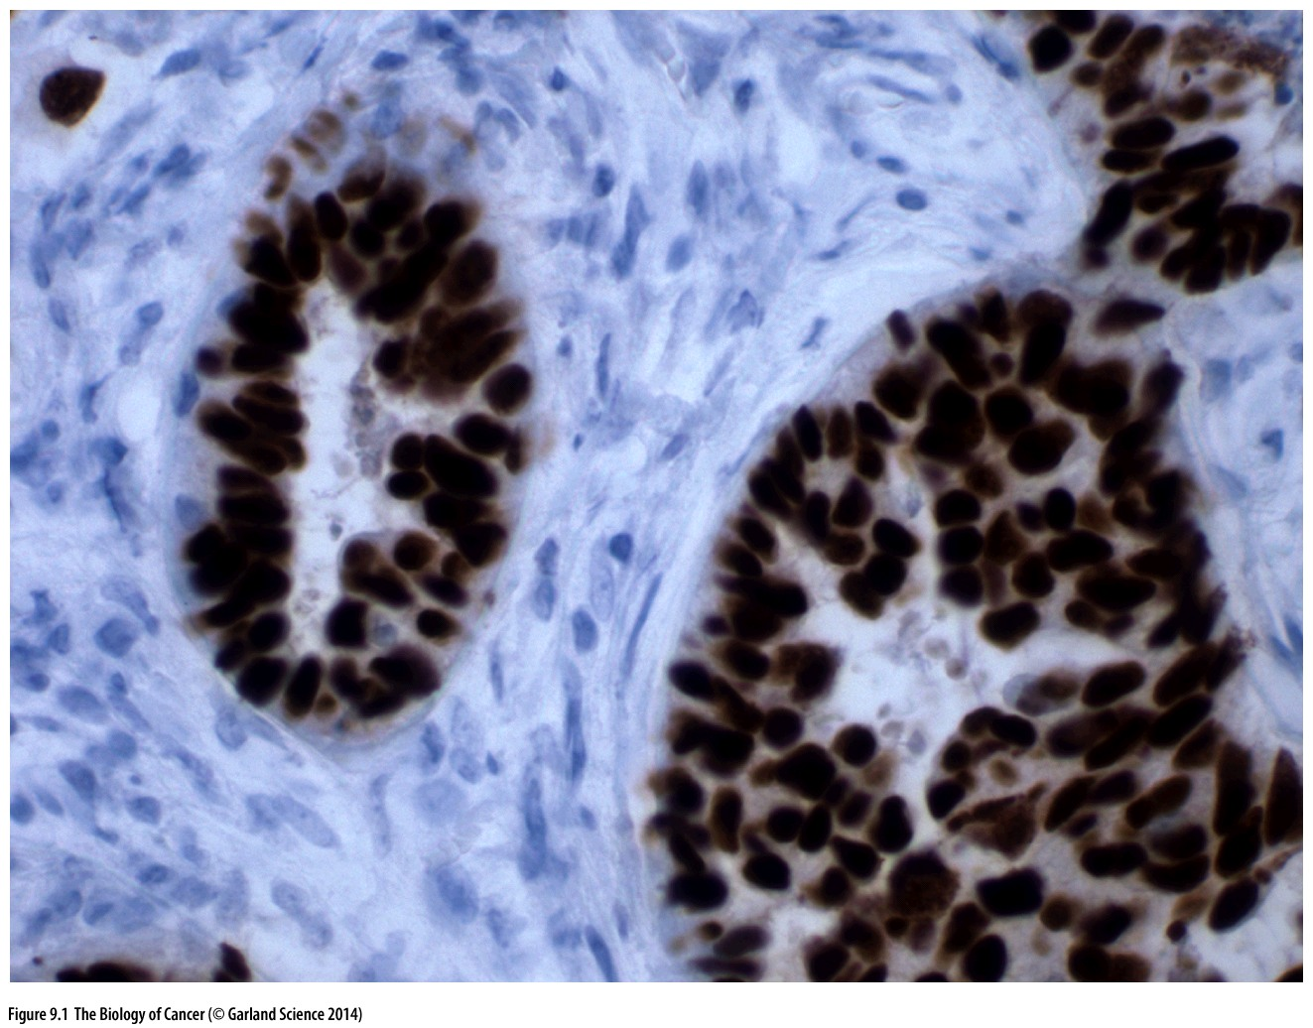
Figure 9.1 Large T antigen in SV40-transformed cells
Antibodies that bind the SV40 large T (LT) antigen can be used to detect LT in the nuclei of SV40- transformed tumor cells.
Immunohistochemistry

Slide 5
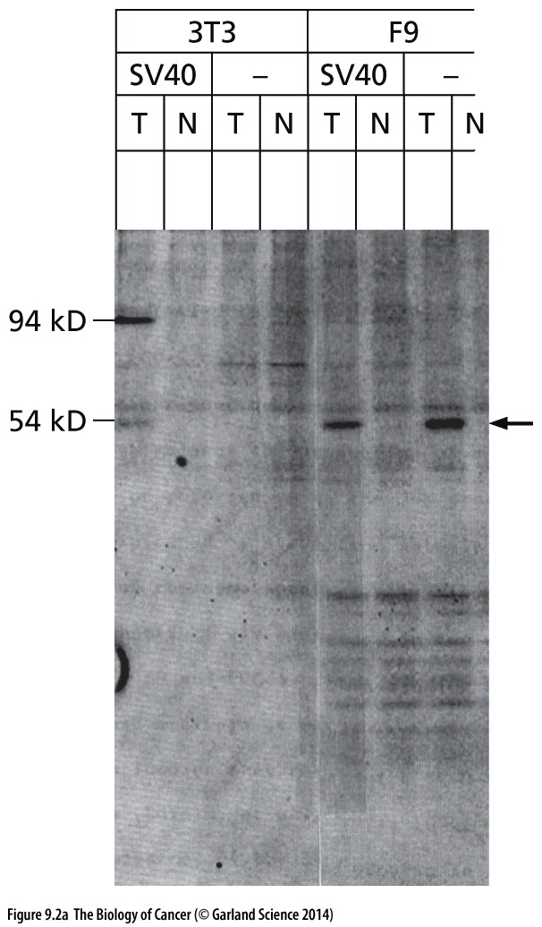
Figure 9.2 The discovery of p53 and its association with SV40 large T
N: Normal
T: Tumor
Experiments performed around 1979
p53
Immunoblot with antisera against p53
Anti-Large T serum IP→ gel stain
Lane, DP & Crawford, LV. (1979). T antigen is bound to a host protein in SV40-transformed cells. Nature, 278 (5701), 261-3
Notes:
注意p53在肿瘤中表达高于正常组织， meaning?

Slide 6
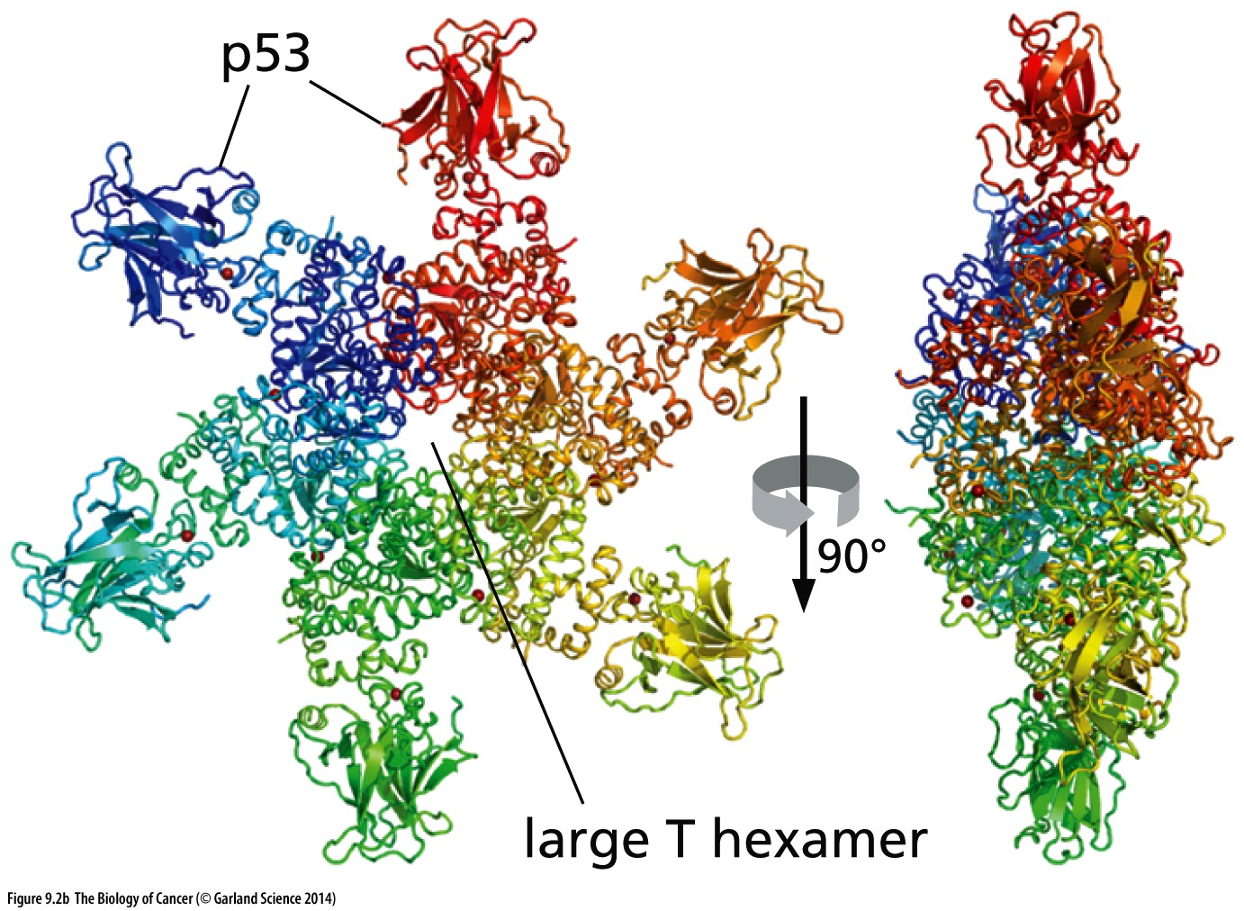
Figure 9.2 The discovery of p53 and its association with SV40 large T
SV40 large T molecules assemble into homohexamers（同源六聚体）, each subunit of which binds and thereby sequesters a single molecule of p53.
Notes:
Larget T 结合p53的具体细节仅供参考，值得注意的是，Large T同时也可结合Rb蛋白，并抑制其活性。

Slide 7
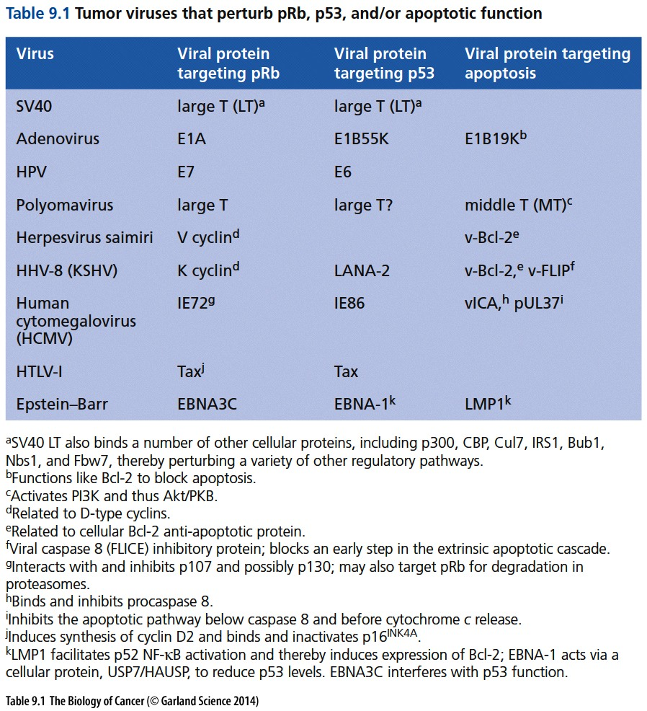
Notes:
一些DNA 肿瘤病毒蛋白能够抑制 Rb， P53活性

Slide 8
9.2 p53 is discovered to be a tumor suppressor gene

Slide 9
p53 from oncogene to tumor suppressor
The initial functional studies of p53 involved a substantial scientific detour: transfection of a p53 cDNA clone into rat embryo fibroblasts revealed that this DNA could collaborate with a co-introduced ras oncogene in the transformation of these rodent cells. Such activity suggested that the p53 gene might operate as an oncogene, much like the myc oncogene.
By 1987 it became apparent that such point-mutated alleles of p53 are common in the genomes of a wide variety of human tumor cells. Data accumulated from diverse studies indicated that the p53 gene is mutated in 30 to 50% of commonly occurring human cancers (Figure 9.4).
Notes:
最早p53被认为是oncogene，因为过表达的P53促进肿瘤生长，后来发现那些过表达实验中用的是突变p53

Slide 10
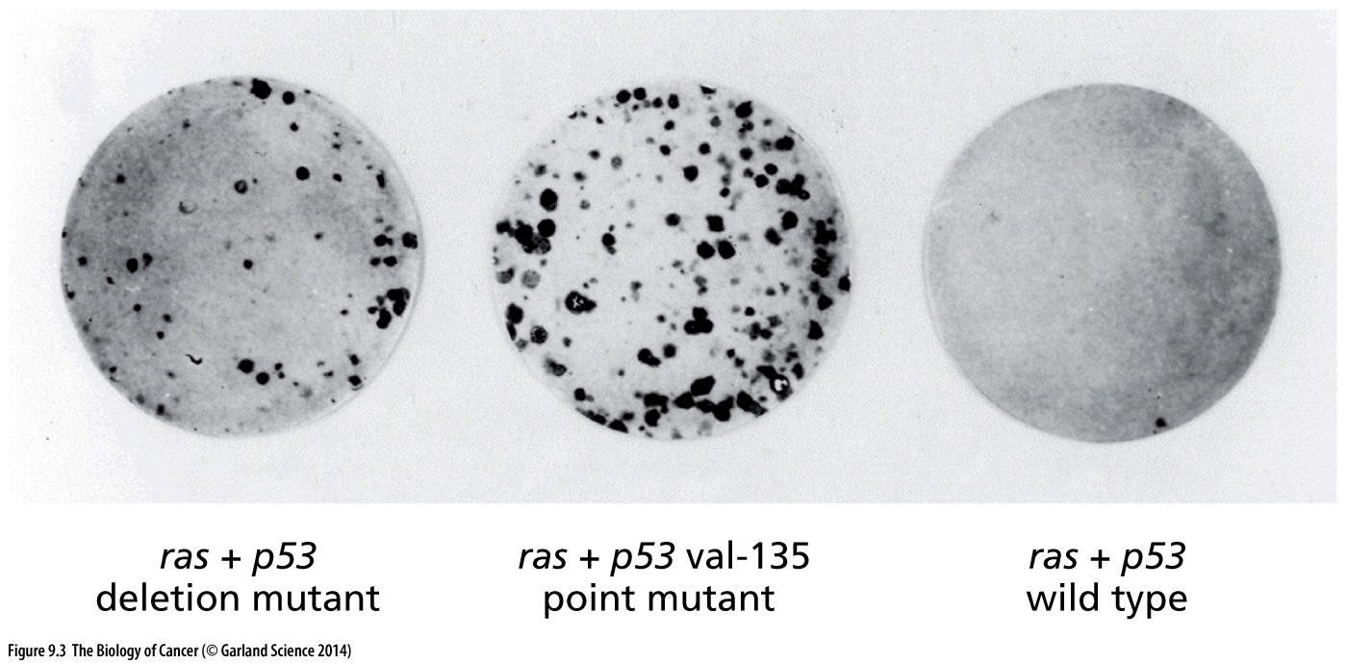
Figure 9.3 Effects of p53 on cell transformation
A cDNA encoding a ras oncogene was co-transfected with several alternative forms of a p53 cDNA into rat embryo fibroblasts. In the presence of a p53 dl mutant vector, which contains an almost complete deletion of the p53 reading frame (left), a small number of foci were formed. In the presence of a p53 point mutant (middle), a large number of robust foci were formed. However, in the presence of a p53 wild-type cDNA clone (right), almost no foci were formed. (Courtesy of M. Oren; from D. Michalovitz et al., Cell 62:671–680, 1990.)

Slide 11
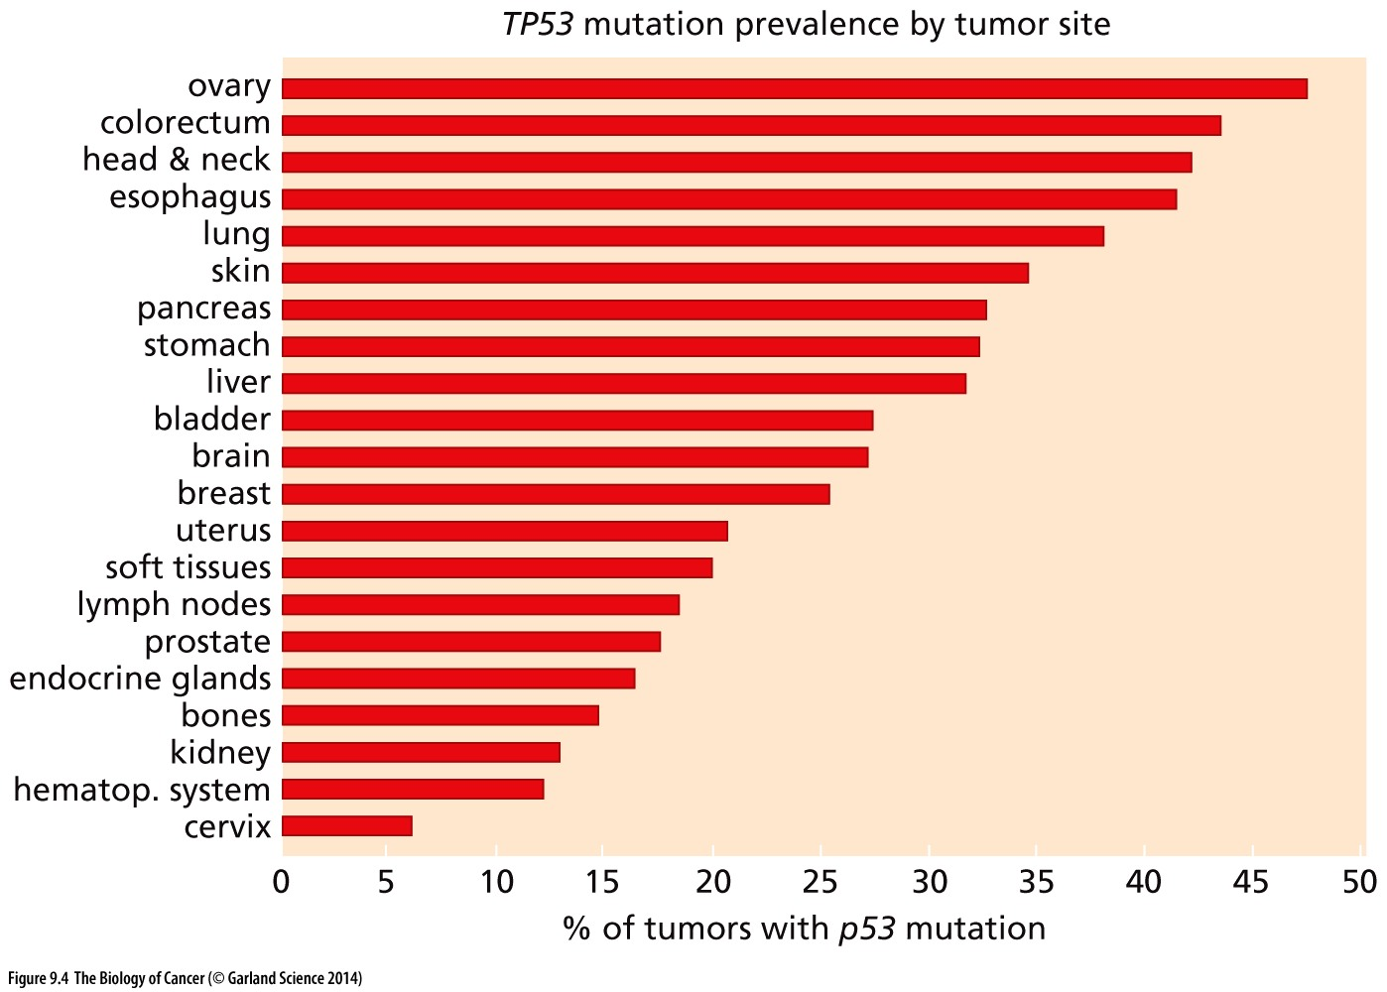
Figure 9.4 Frequency of mutant p53 alleles in human tumor cell genomes

Slide 12
P53 is the most significantly mutated gene in human cancers
Tp53 show mutation hotspots, and significant truncating mutation
http://www.cbioportal.org/
Notes:
P53实际突变的比例比书上描述的多，目前p53是癌症突变最多的基因!

Slide 13
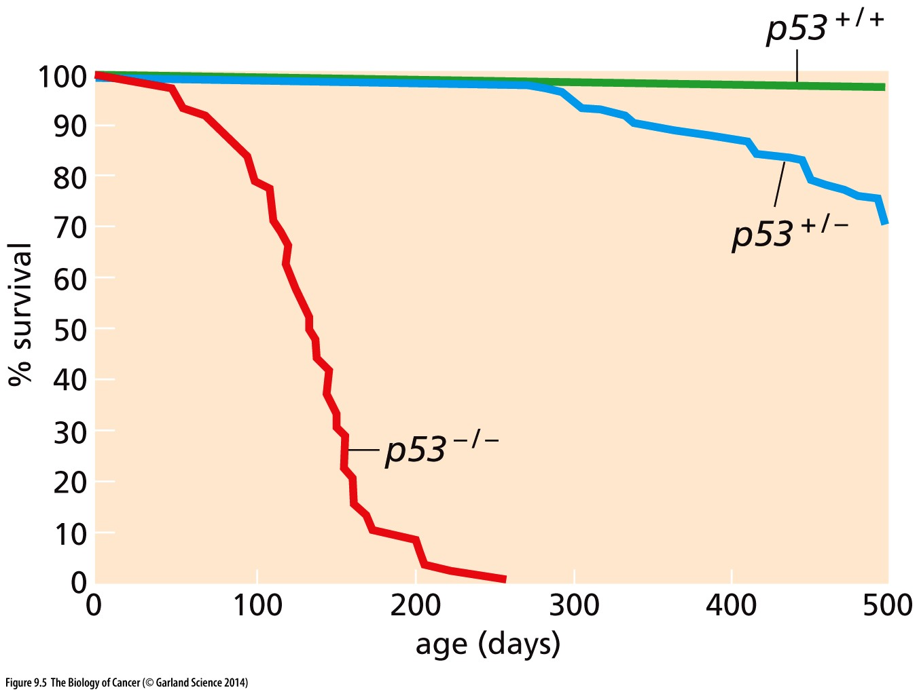
Figure 9.5 Effects of mutant p53 alleles in the mouse germ line
This Kaplan–Meier plot indicates the percent of mice of the indicated genotype that survived (ordinate) as a function of elapsed lifetime in days (abscissa). While the absence of p53 function in the p53–/– mice had relatively little effect on their embryonic development and viability at birth, it resulted in a greatly increased mortality relatively early in life, deriving largely from the development of sarcomas and leukemias.

Slide 14
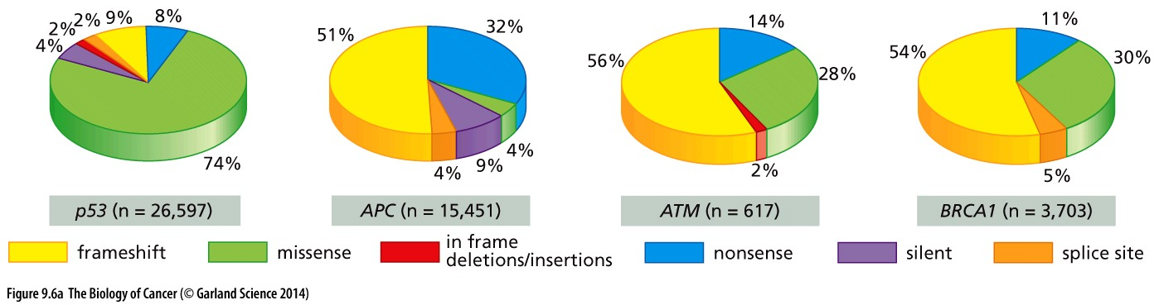
Figure 9.6 Nature of p53 mutations
Significant missense mutation in p53 gene
Notes:
P53 missense mutation could provide growth advantage

Slide 15
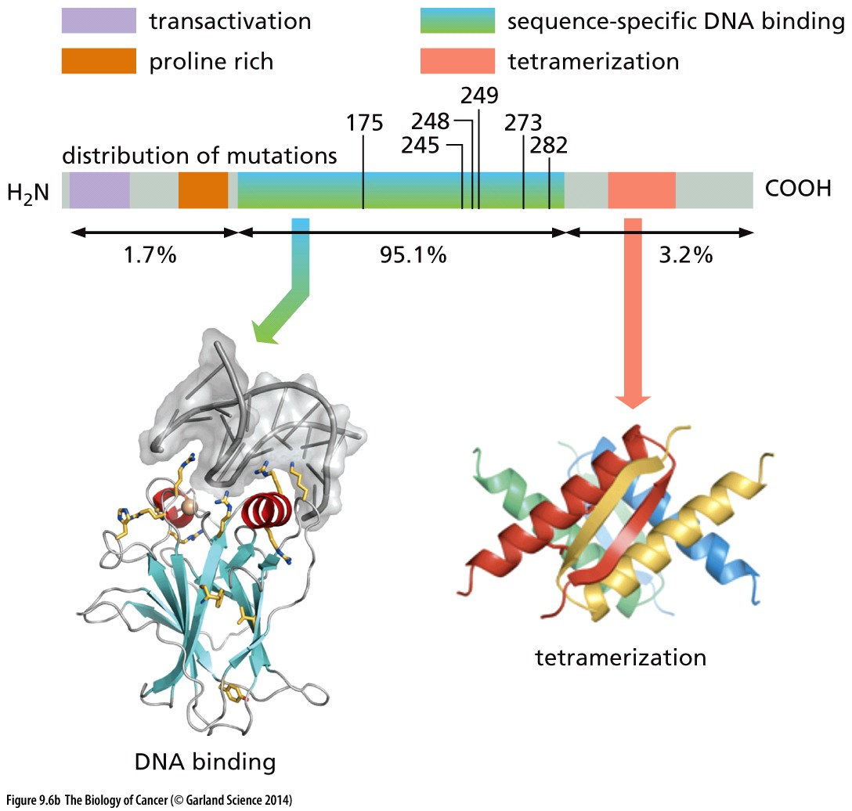
Figure 9.6 Nature of p53 mutations
The locations across the p53 reading frame of the point mutations causing amino acid substitutions are plotted here (above). As is apparent, the great majority of p53 mutations (95.1%) affect the DNA-binding domain of the p53 protein.

Slide 16
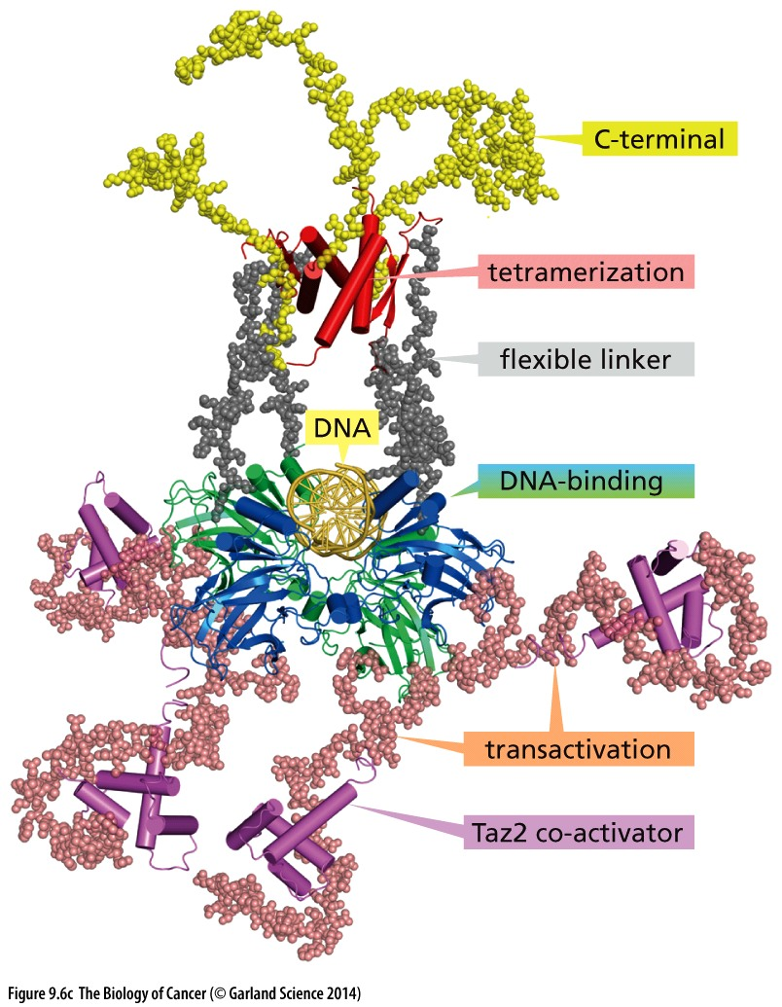
Figure 9.6 Nature of p53 mutations
Structure of the DNA-bound p53 tetramer（四聚体） is shown

Slide 17
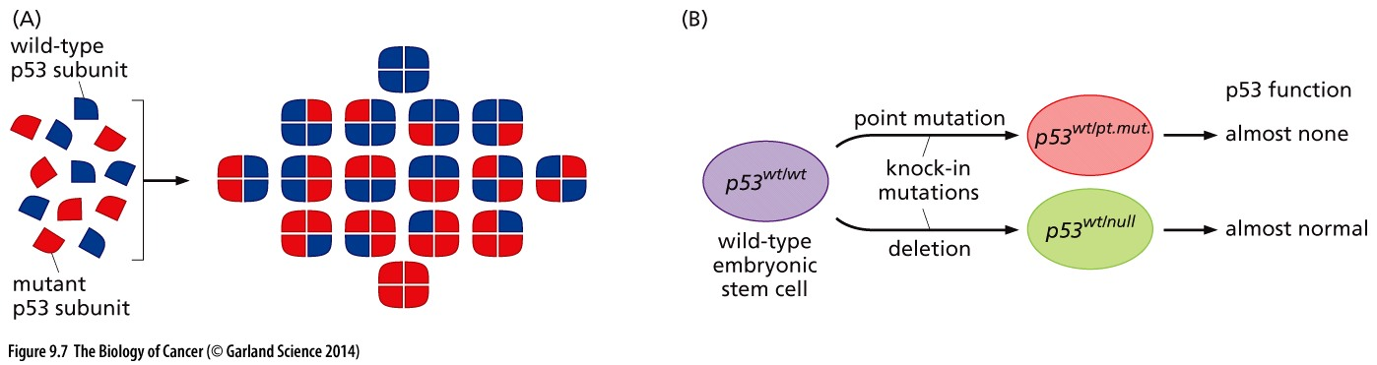
Figure 9.7 p53 structure and p53 function as a dominant-negative allele
Notes:
这解释了为什么一开始P53被认为是oncogene, 以及 为什么p53有那么多missense mutation

Slide 18
9.4 p53 protein molecules usually have short lifetimes
9.5 A variety of signals cause p53 induction

Slide 19
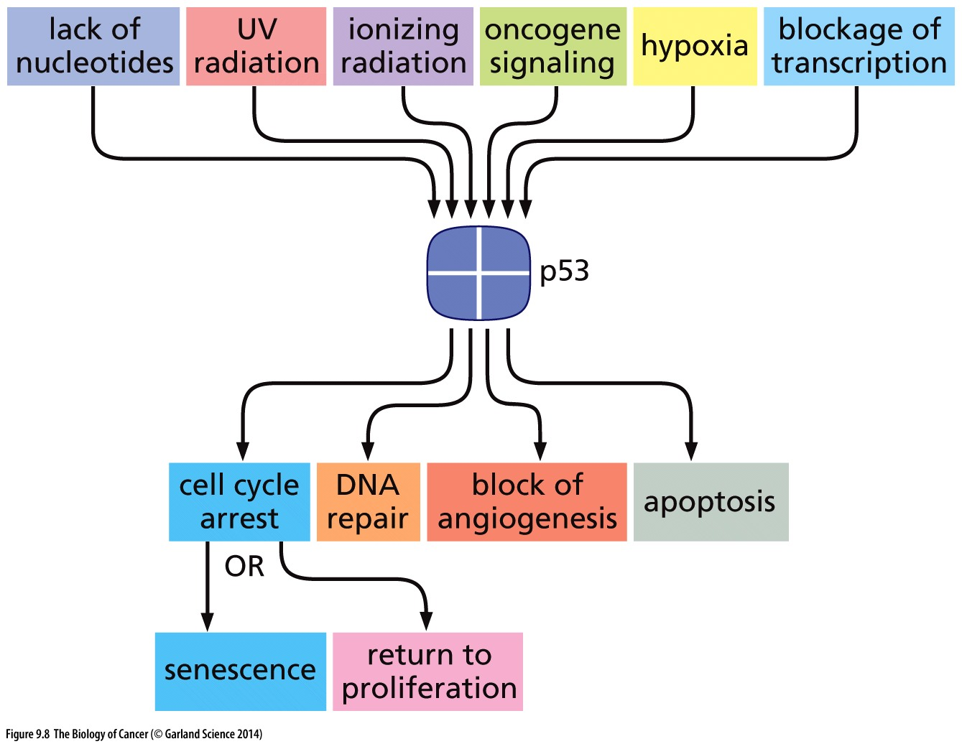
Figure 9.8 p53-activating signals and p53’s downstream effects
Cellular stresses
p53
Cell stop or die
Notes:
一张重要的总结ppt, 系统总结p53的上游调控信号，下游生物学功能，

Slide 20
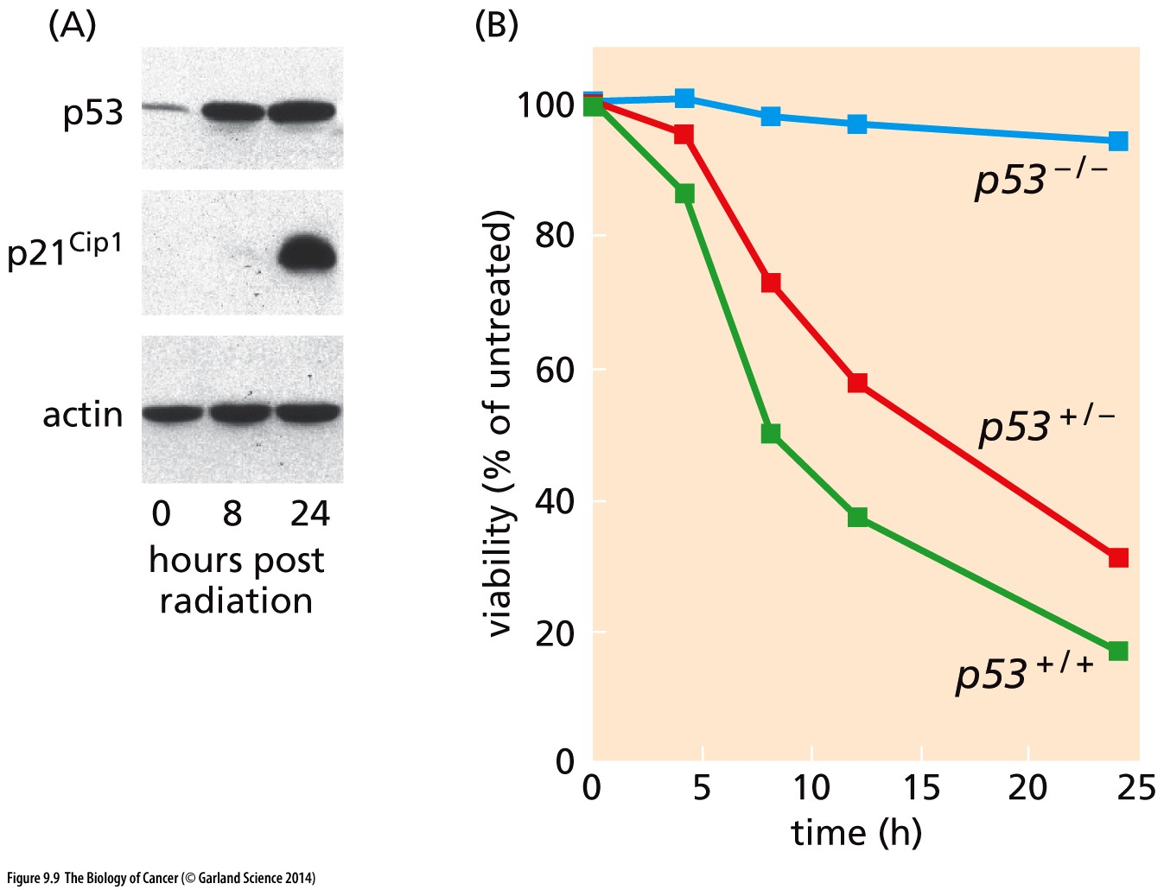
Figure 9.9 p53 and the radiation response

Slide 21
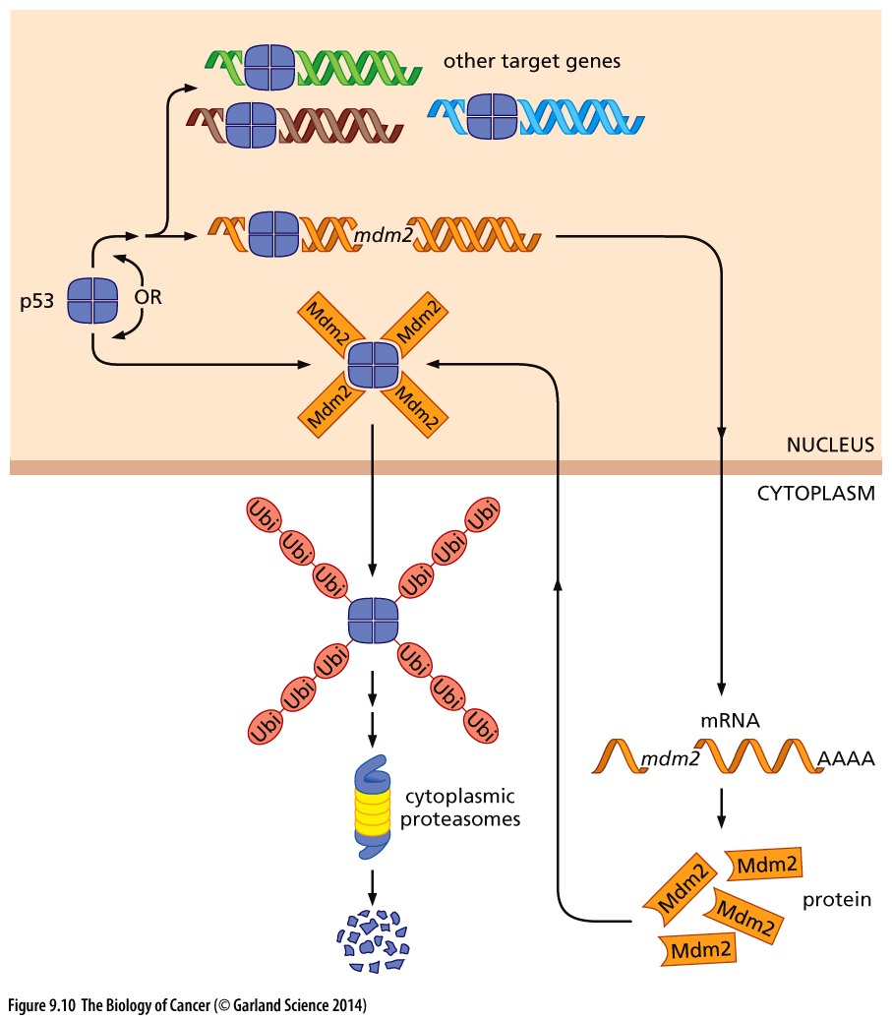
Figure 9.10 Control of p53 levels by Mdm2
Mdm2
p53
Notes:
P53蛋白不稳定的一个原因

Slide 22
Mdm2’s primary function is to control p53

Slide 23
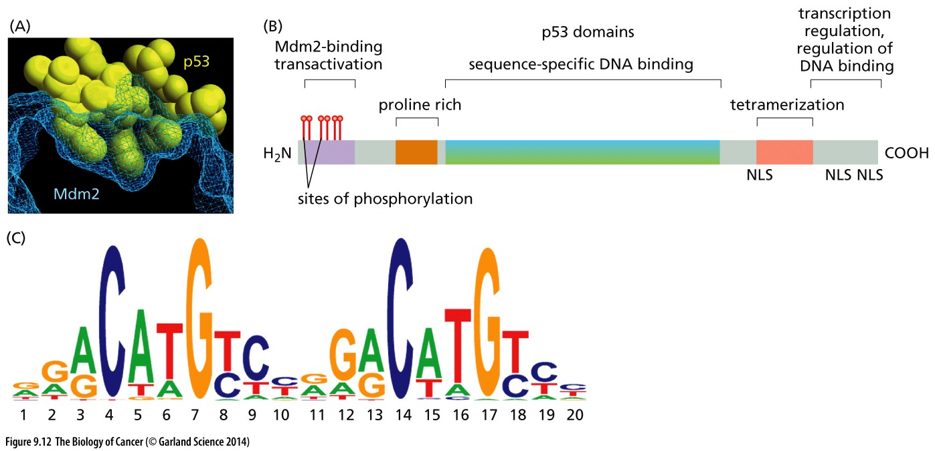
Figure 9.12 Specialized domains of p53
Notes:
P53最基本的功能是作为转录因子

Slide 24
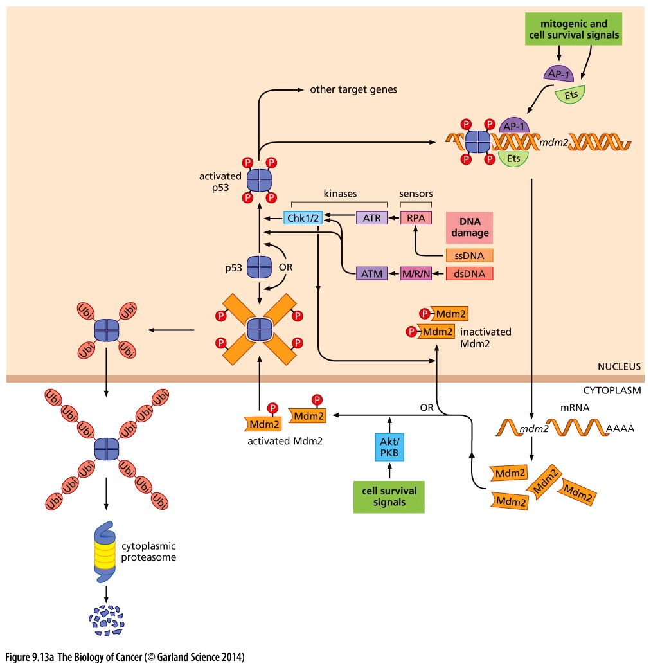
Figure 9.13 Control of p53 levels by various kinases
Chk1/2, ATM
AKT
p53
Mdm2

Slide 25
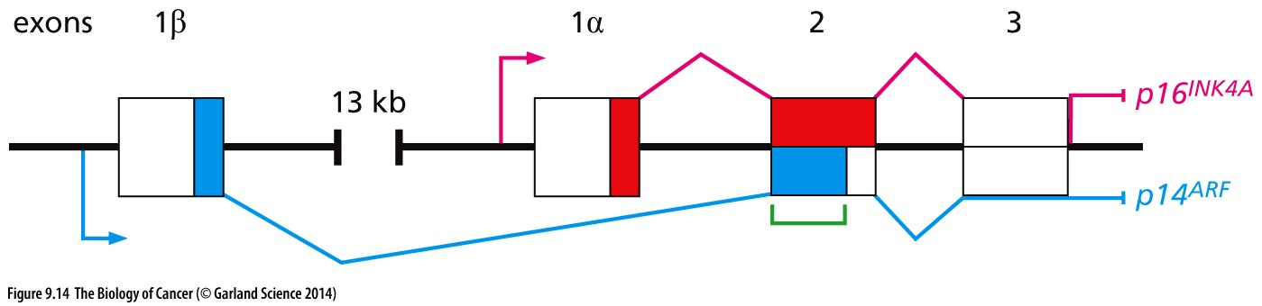
Figure 9.14 The gene encoding p16INK4A and p14/p19ARF
ARF MDM2 P53
P16 is CDK inhibitor, also a tumor suppressor

Slide 26
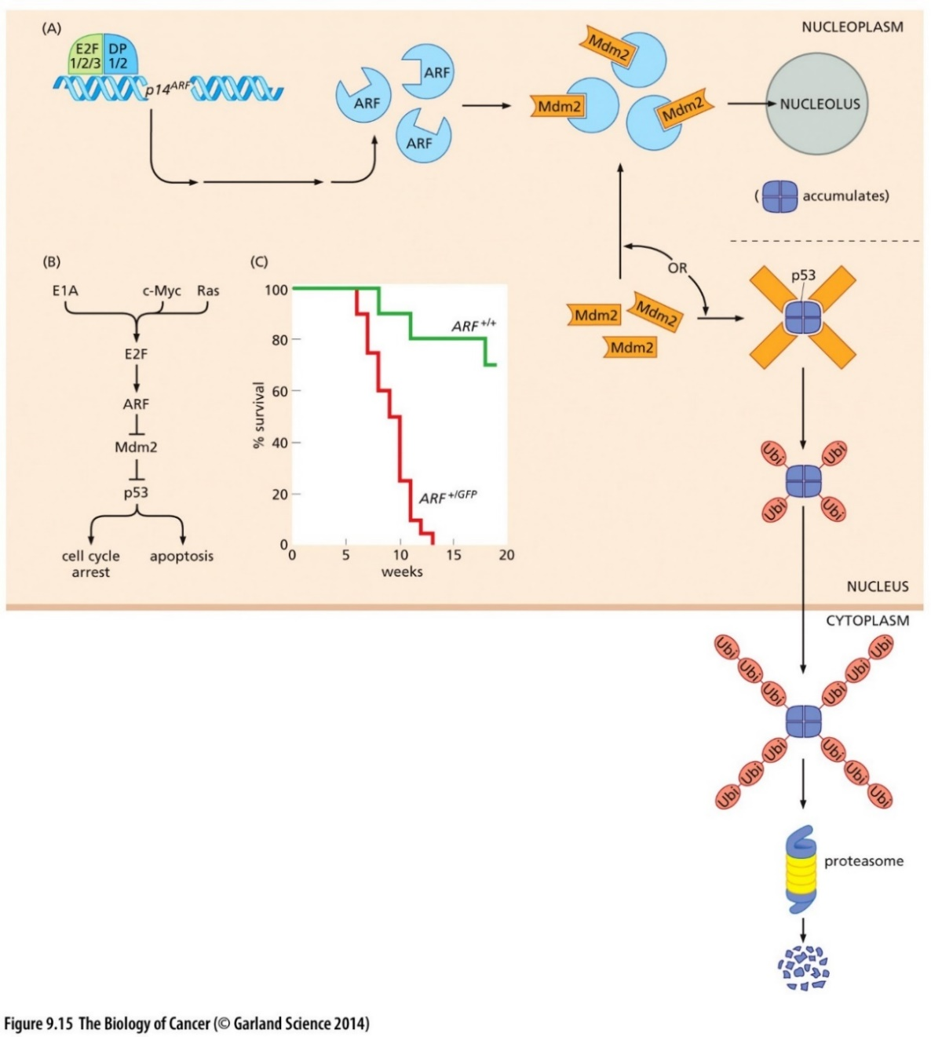
Figure 9.15 Control of apoptosis by ARF
Oncogene
ARF MDM2 P53
Apoptosis
Oncogene activation and ARF up-regulation

Slide 27
9.9 p53 functions as a transcription factor that halts cell cycle advance in response to DNA damage and attempts to aid in the repair process

Slide 28
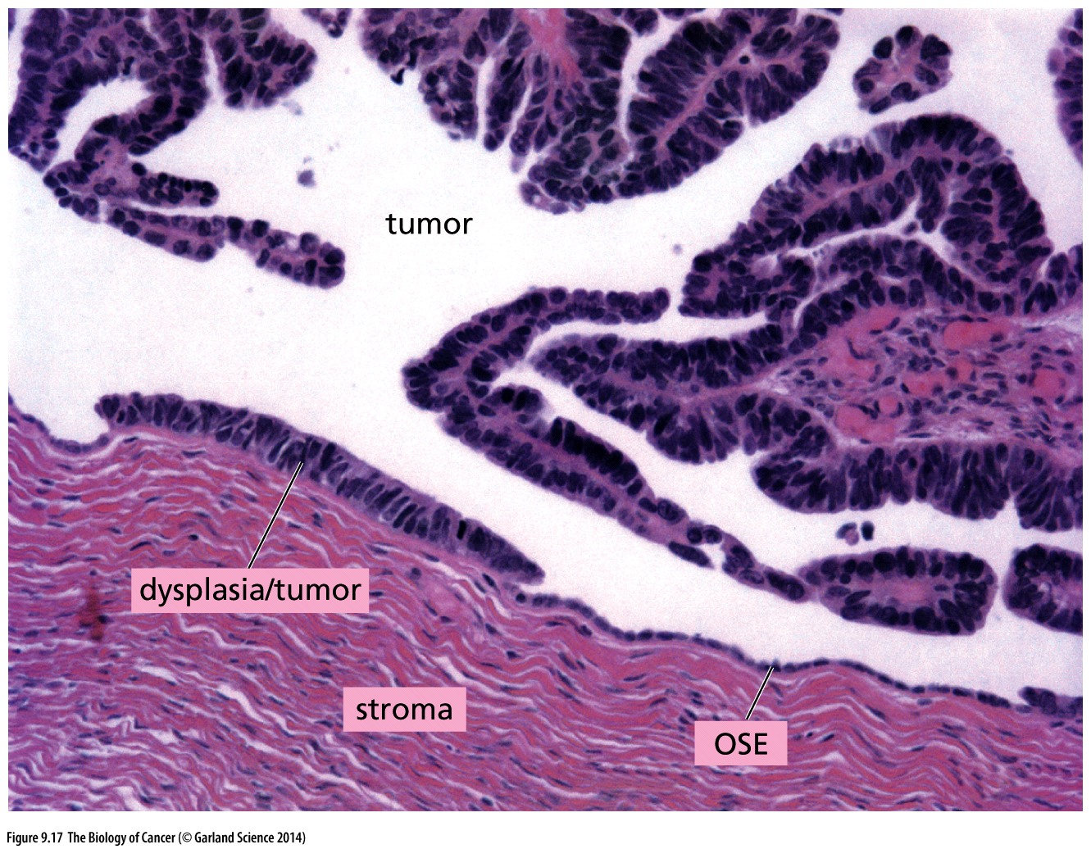
Figure 9.17 Accumulation of p53 in p53-mutant cells
Immunohistochemistry with anti-p53 antibody
P53 mutation → unable to induce mdm2 → more P53 accumulation

Slide 29
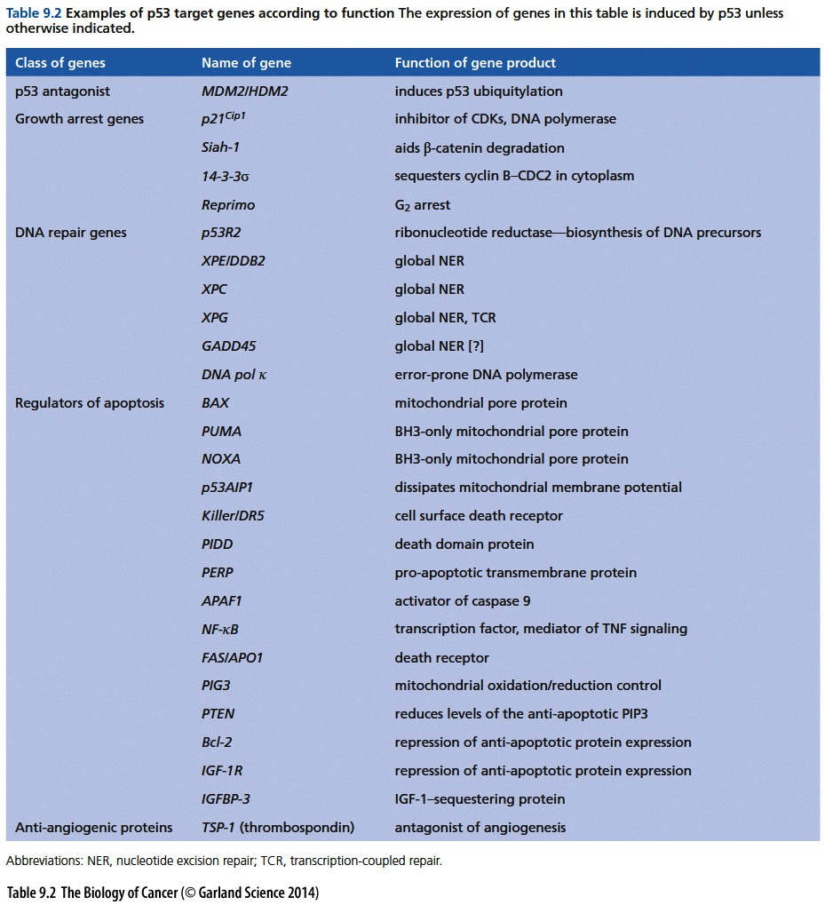
P53 is a transcription factor
P53 target genes:
MDM2
Growth arrest genes(p21…)
DNA repair genes;
Apoptosis related(BAX,PUMA…)

Slide 30
9.10 p53 often ushers(引领) in the apoptotic death program

Slide 31
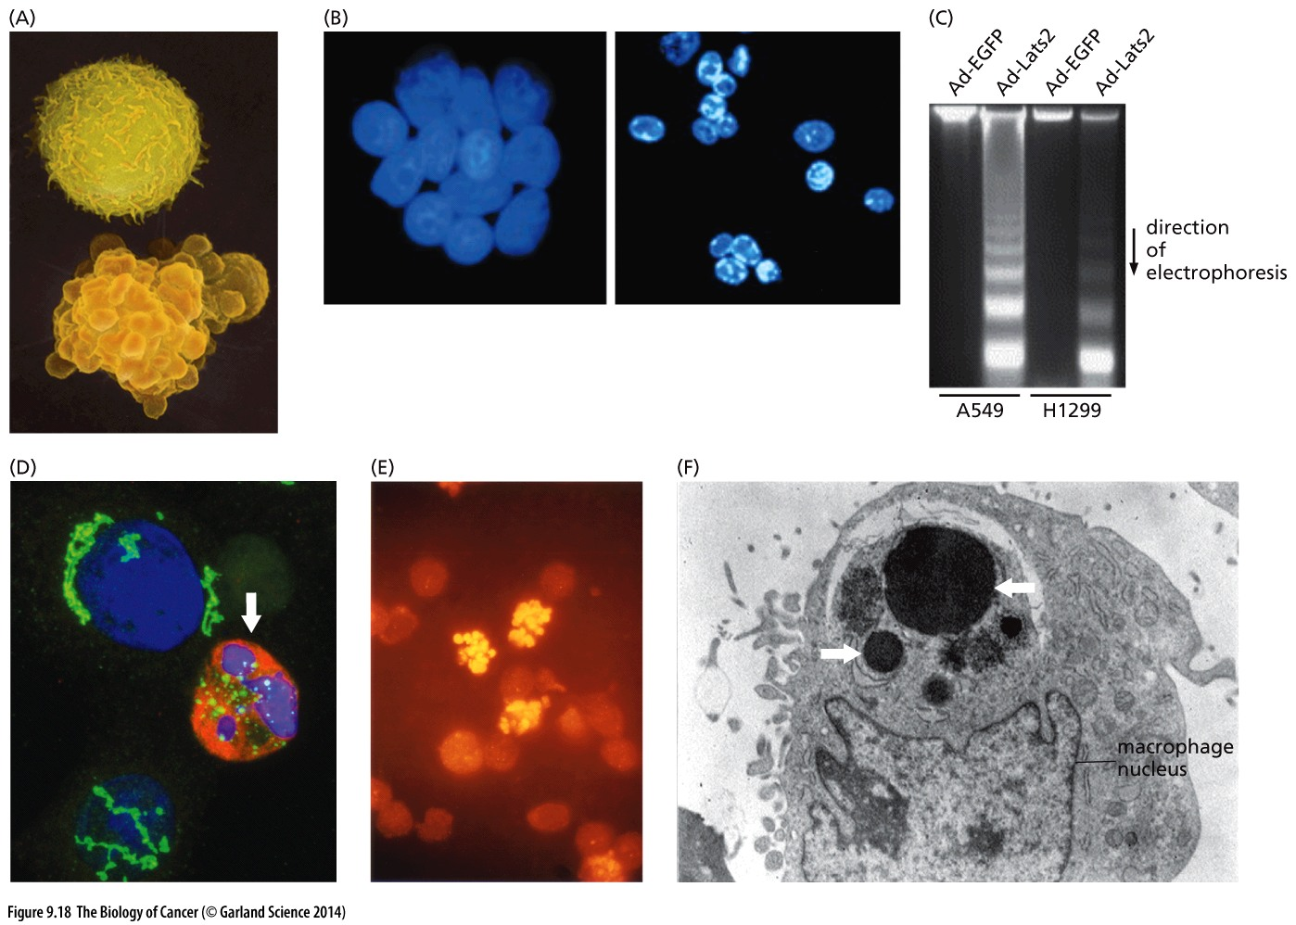
Figure 9.18 Diverse manifestations of the apoptotic program

Slide 32
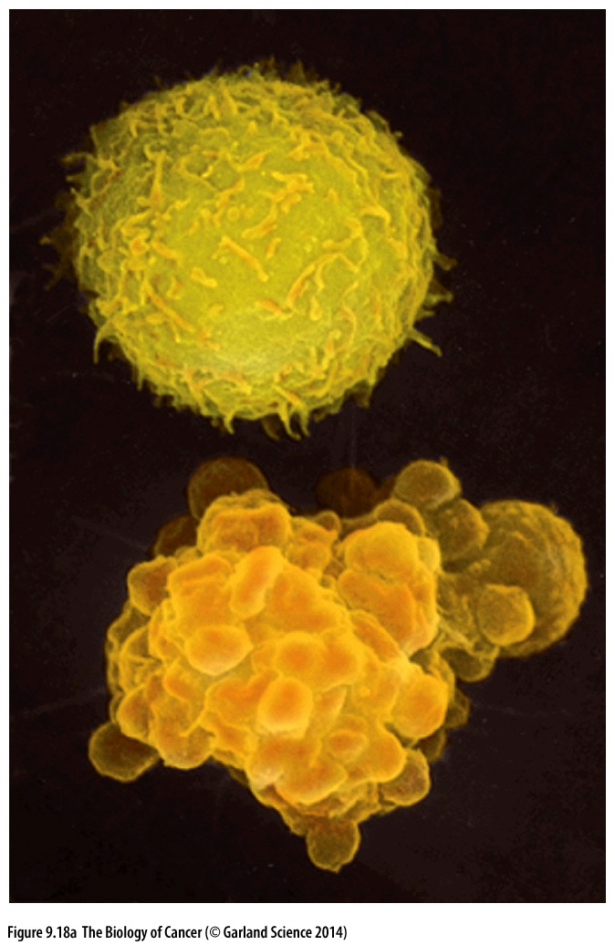
Figure 9.18 Diverse manifestations of the apoptotic program
Health
Apoptotic
Two lymphocytes, visualized by scanning electron microscopy (SEM),

Slide 33
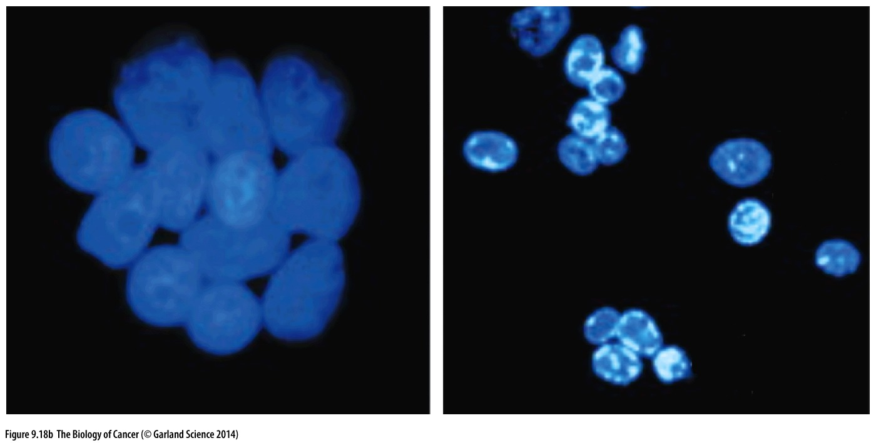
Figure 9.18 Diverse manifestations of the apoptotic program
HeLa cells—a line of human cervical carcinoma cells—have been fused, forming a syncytium (left). Prior to fusion, some of these cells were treated with staurosporine, an apoptosis inducing drug. As a consequence, these cells’ nuclei, which normally are quite large (left), have undergone pyknosis （固缩）(right), a process that accompanies apoptosis and involves condensation of chromatin (white) and collapse of nuclear structure. Fragmentation of nuclei (not shown) follows soon thereafter

Slide 34
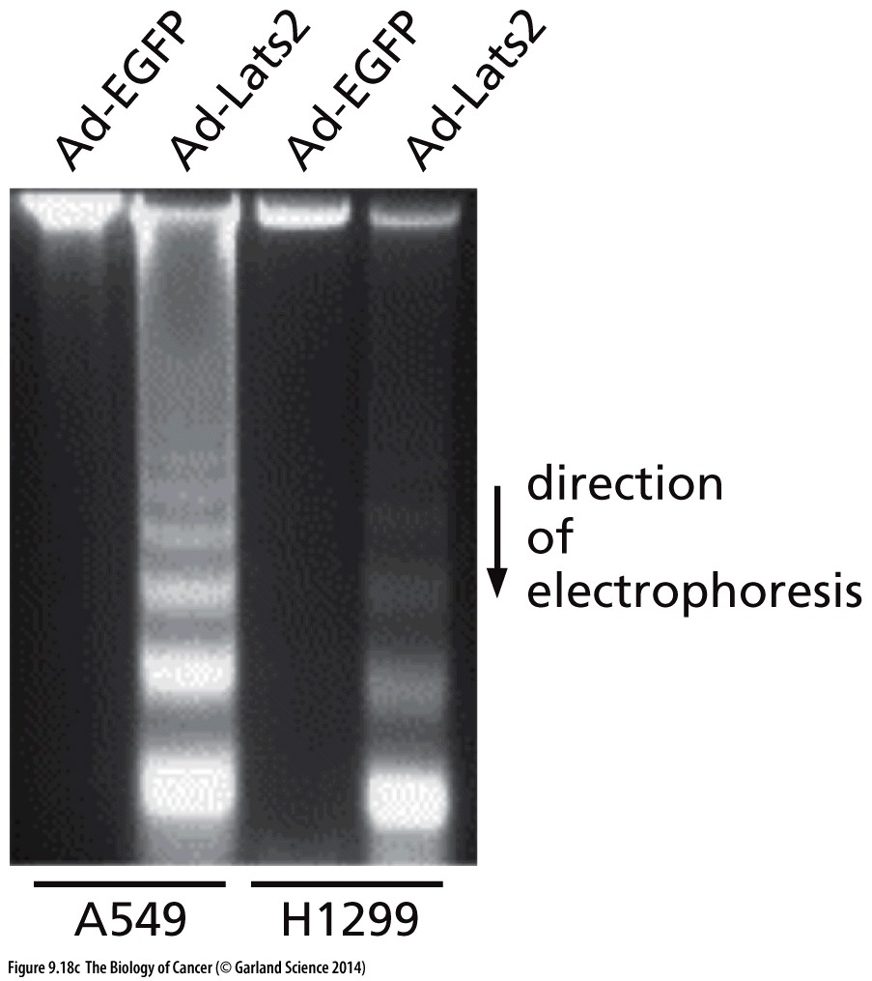
Figure 9.18 Diverse manifestations of the apoptotic program
When apoptosis is induced, in this case through the expression of the pro-apoptotic Lats2 protein (2nd, 4th channels) introduced via an adenovirus (Ad) vector, the normally high–molecular-weight DNA of A549 and H1299 cells (1st, 3rd channels) is cleaved into low–molecularweight fragments that run rapidly upon gel electrophoresis, forming a “DNA ladder”
Notes:
细胞凋亡伴随着基因组DNA的切割和碎片化

Slide 35
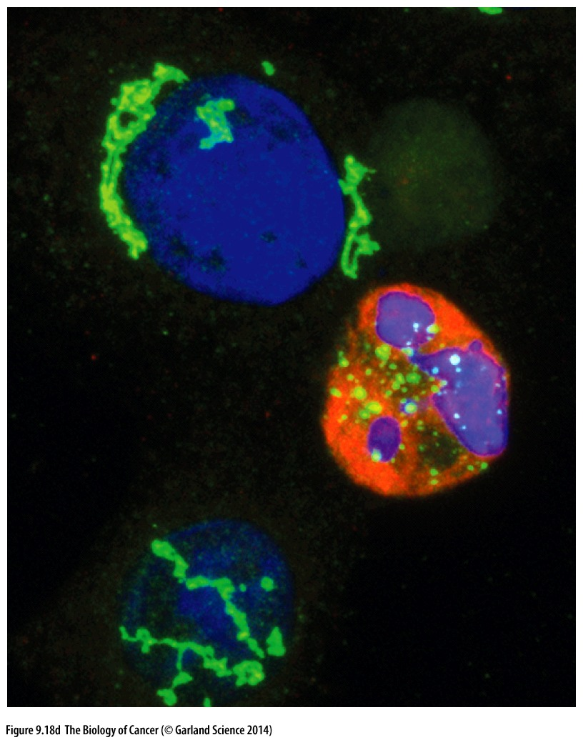
Figure 9.18 Diverse manifestations of the apoptotic program
The Golgi bodies (green) are usually found in perinuclear locations in a normal cell (upper left), while in an apoptotic cell (arrow), the Golgi bodies have become fragmented. Chromatin is stained blue, while an antibody specific for cleaved PARP [poly(ADP-ribose) polymerase], which is split during apoptosis, reveals this form of the protein (red) in the nucleus of an apoptotic cell.
Notes:
PARP参与DNA损伤修复，凋亡细胞PARP被caspase切割

Slide 36
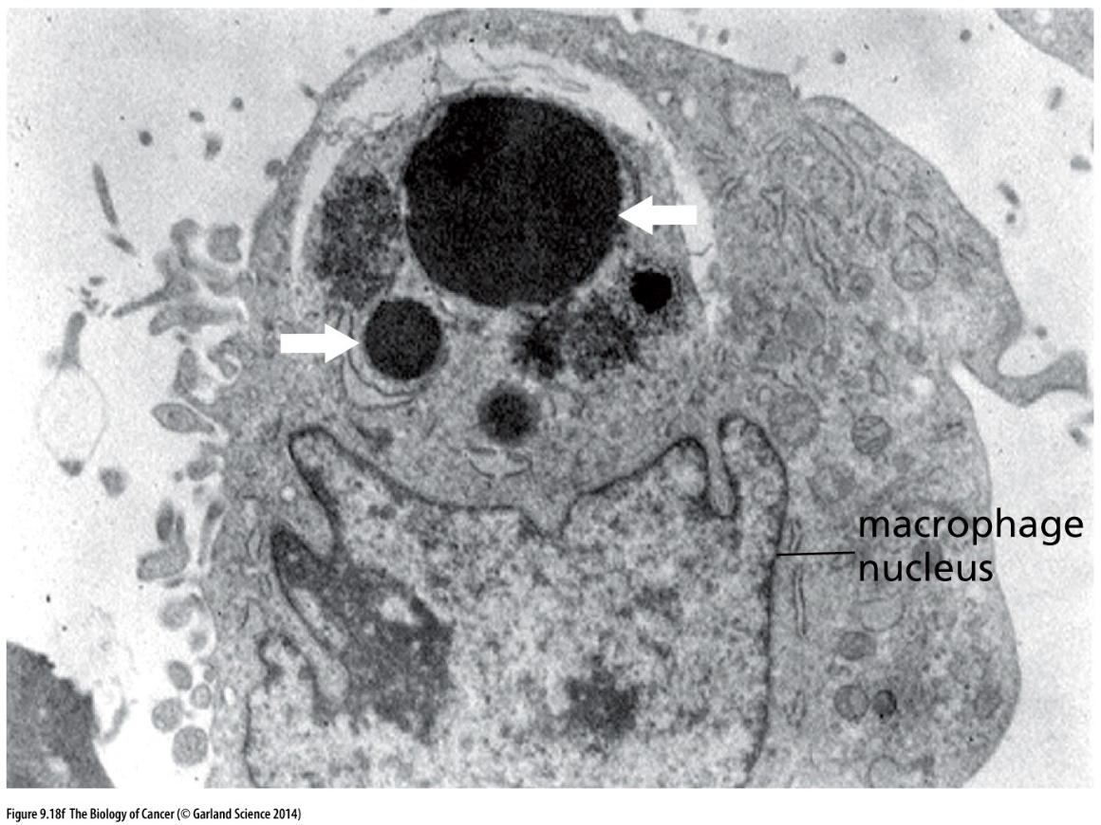
Figure 9.18 Diverse manifestations of the apoptotic program
The end result of apoptosis is the phagocytosis of apoptotic bodies—the fragmented remains of apoptotic cells—by neighbors or by macrophages. In this image, the pyknotic（固缩的） nuclear fragments of a phagocytosed apoptotic cell are seen above (white arrows) and contrast with the normal nucleus of the phagocytosing macrophage (below).

Slide 37
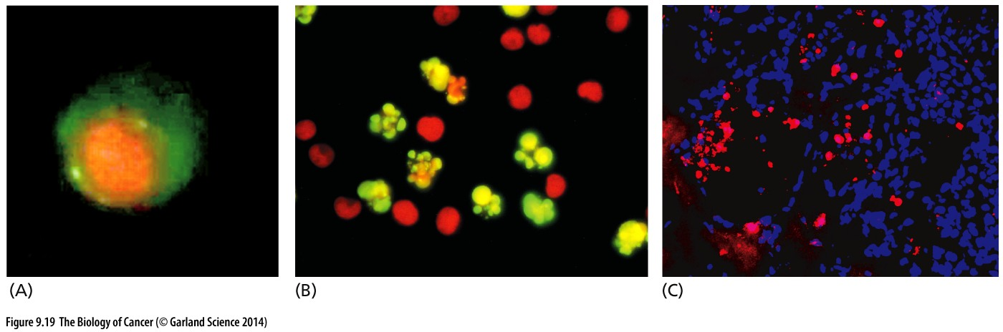
Figure 9.19 Techniques for detecting apoptotic cells
phosphatidylserine (PS)
BrdUTP
cleaved caspase 3
(A) Early in the apoptotic program, phosphatidylserine (PS) molecules, which are normally exposed on the inner surface of the plasma membrane, are flipped and therefore become exposed on the outer surface. PS is bound by the annexin V protein, which here has been coupled to a fluorescent dye and used to detect exposed, cell-surface PS (green).
(B) In the TUNEL assay, apoptotic cells (yellow green, above) are detected because their chromosomal DNA has become fragmented, exposing 3ʹ DNA ends that can be extended by the terminal deoxyribonucleotide transferase (TdT) enzyme which in this case uses BrdUTP (bromodeoxyuridine triphosphate) as its substrate. The resulting oligonucleotide tails can be detected with an anti- BrdU monoclonal antibody that has been coupled to a dye molecule (yellow green).
(C) A fluorescent dye–tagged antibody for cleaved (and therefore activated) caspase 3 (red), which plays a prominent role in the apoptotic program, and the DAPI stain for cell nuclei (blue) have been used to stain an MMTV-Neu mouse breast carcinoma.
Notes:
BrdU也可以用来标记增殖细胞

Slide 38
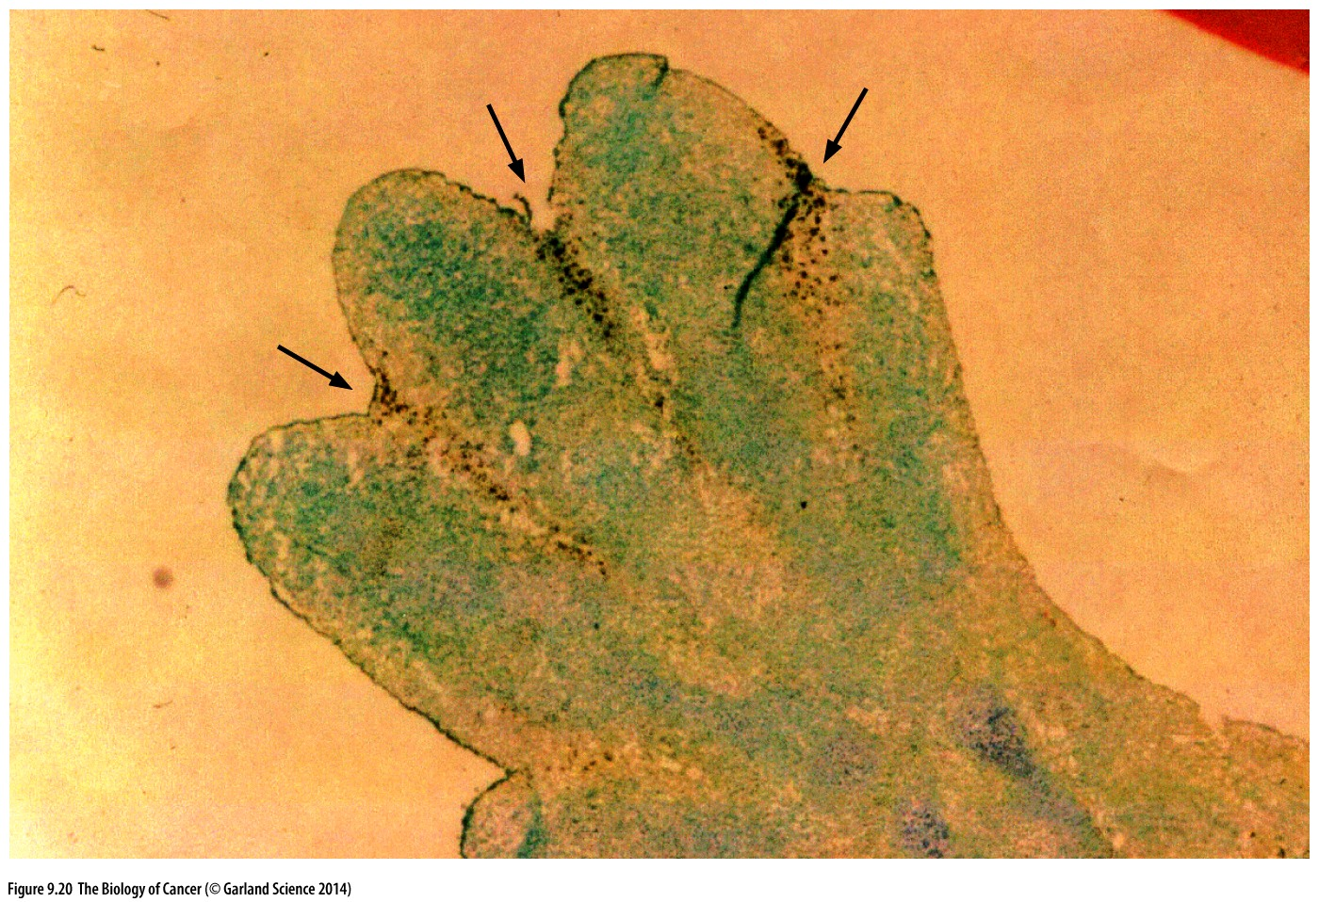
Figure 9.20 Apoptosis and normal morphogenesis
Apoptotic cells were preferentially labeled, as indicated by the numerous dark dots (arrows), using the TUNEL assay. The apoptosis of cells forming the webs ultimately results in the formation of fingers that are joined by webs only near the palm.
Notes:
细胞凋亡是正常个体发育必不可少的一个环节。

Slide 39
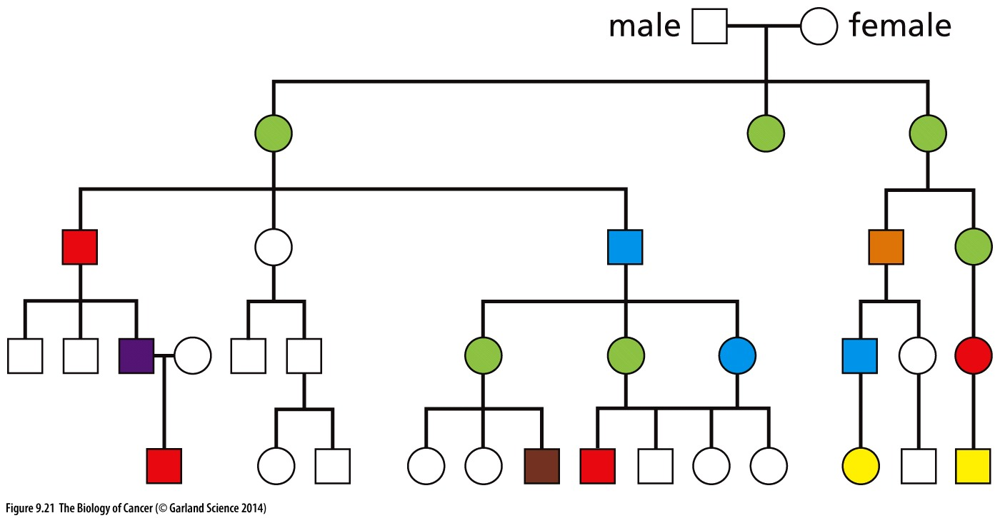
Figure 9.21 Familial cancer susceptibility due to mutant p53 germ-line alleles
This pedigree of a family suffering Li–Fraumeni syndrome reveals a variety of cancers arising at elevated incidence levels. This diversity of cancer types contrasts with most familial cancer syndromes, in which a single type of cancer is usually seen to occur at elevated frequency. Family members developed the following malignancies: breast cancer (green), glioblastoma (yellow), leukemia (purple), lung cancer (blue), pancreatic carcinoma (orange), sarcoma (red), Wilms tumor (brown); males (squares), females (circles). (From F.P. Li and J.F. Fraumeni, J. Am. Med. Assoc. 247:2692–2694, 1982.)
Notes:
P53人类家系突变后 与 其他tumor suppressor家系突变所诱发的肿瘤 区别是： 肿瘤发生类型多

Slide 40
9.13 Apoptosis is a complex program that often depends on mitochondria
Notes:
本次课第二部分内容：细胞凋亡及其机制

Slide 41
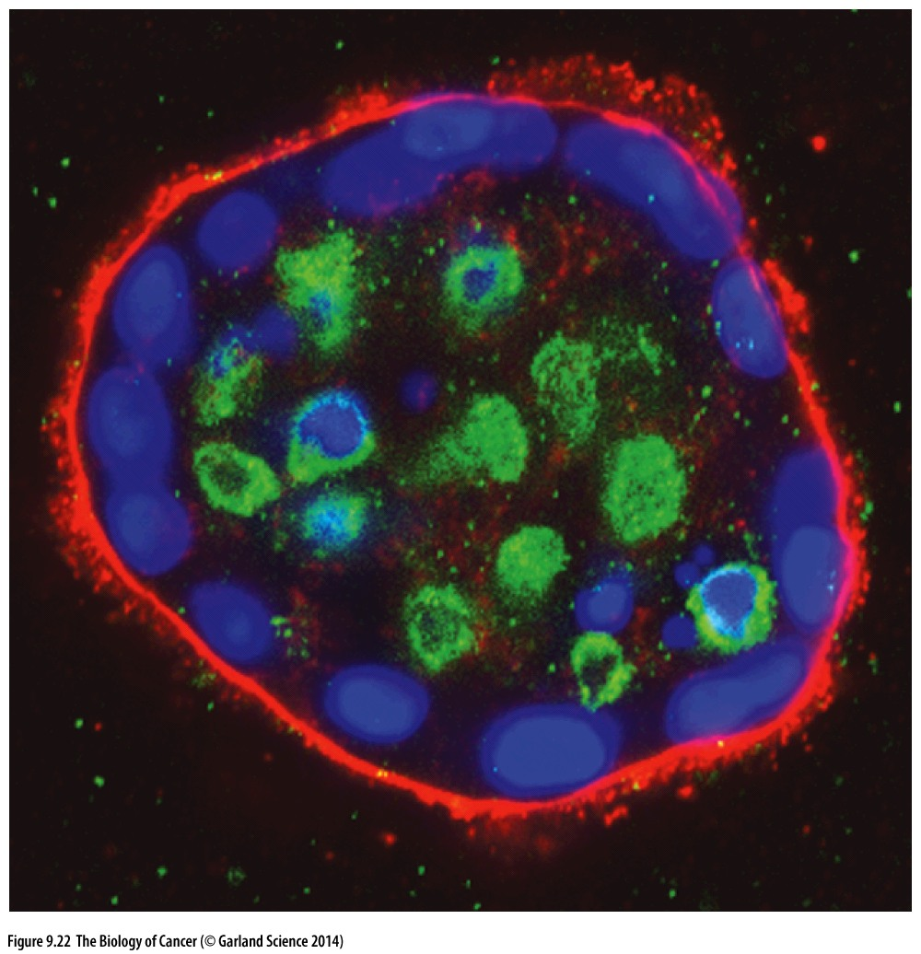
Figure 9.22 Anoikis （失巢凋亡） triggered by loss of anchorage to extracellular matrix
Human mammary epithelial cells (MECs)
Immuno-staining with an antibody specific for cleaved caspase 3

Slide 42
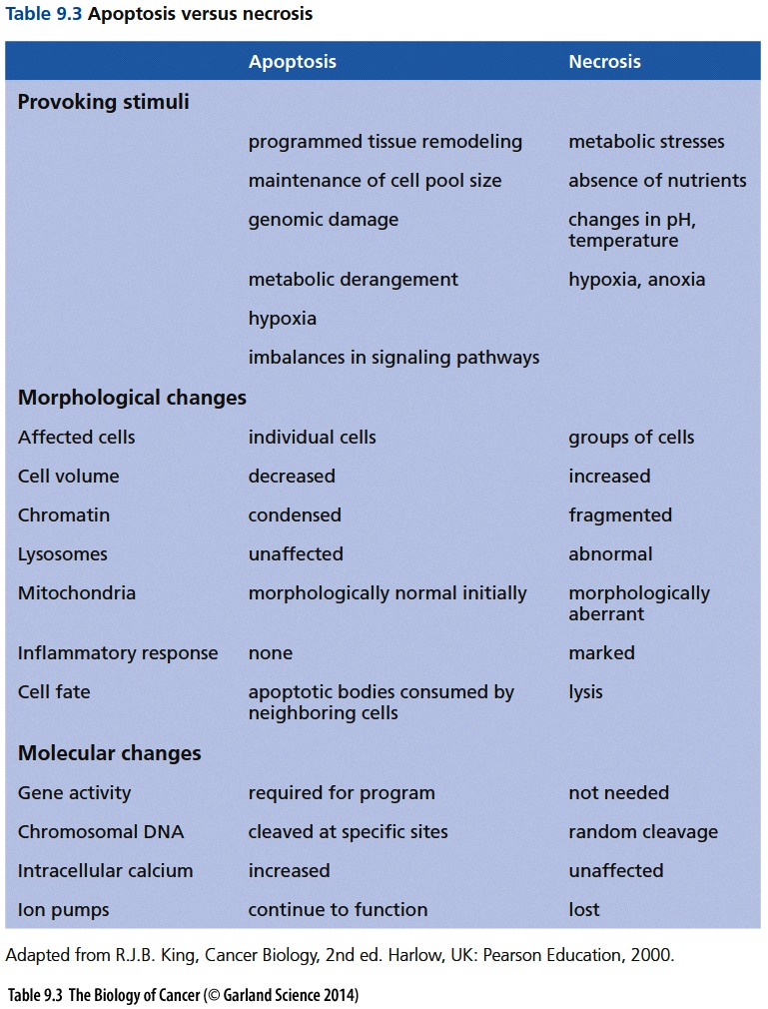
Apoptosis（凋亡）vs necrosis（坏死）

Slide 43
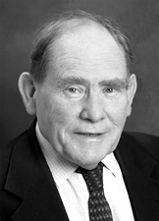

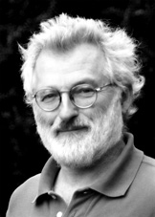
The Nobel Prize in Physiology or Medicine 2002
"for their discoveries concerning genetic regulation of organ development and programmed cell death'"
Sydney Brenner
H. Robert Horvitz
John E. Sulston
Sydney Brenner, establishing Caenorhabditis elegans as a model organism.
John E. Sulston, tracing cell elegans's entire embryonic cell lineage
H. Robert Horvitz, identified the first "death genes", ced-3 and ced-4 in c. elegans in 1986
Notes:
Ced-3: caspase; ced-4: Apaf-1

Slide 44

Cytochrome c and apoptosis
Xiaodong Wang（王晓东 ）
Director and Investigator, NIBS, Beijing, China
Member of the National Academy of Sciences, USA
王晓东 identify cytochrome c as key inducer of apoptosis in 1996
X Liu, CN Kim, J Yang, R Jemmerson, X Wang. Induction of apoptotic program in cell-free extracts: requirement for dATP and cytochrome c. Cell 86 (1), 147-157 (1996)
Notes:
诺贝尔奖级别的科学发现

Slide 45
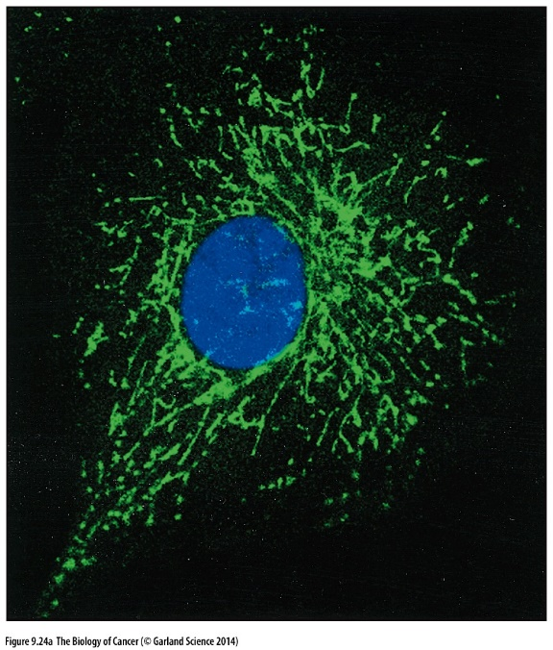
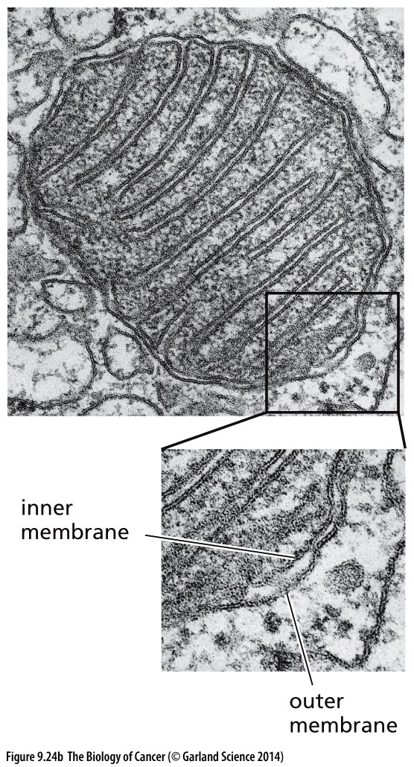
Figure 9.24 Mitochondria
Cytochrome c is stored in the space between the outermost mitochondrial membrane and the inner membranes, where it normally plays a key role in electron transport.

Slide 46
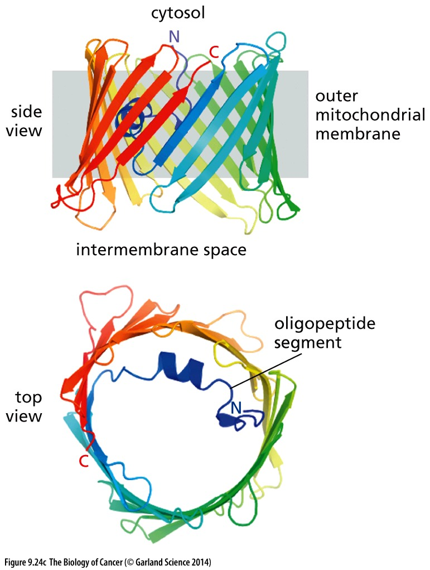
Figure 9.24 Mitochondria
One of the channels embedded in the outer mitochondrial membrane that are responsible for the release of pro-apoptotic proteins into the cytosol is termed VDAC1 (voltage-dependent anion channel 1). The oligopeptide segment within the open channel (blue) appears to be a component of the gating device that governs passage of solutes, including cytochrome c molecules, through this channel. Bcl-XL, an anti-apoptosis regulator, has been found to bind to strands 17 and 18 of the 19-strand channel.

Slide 47
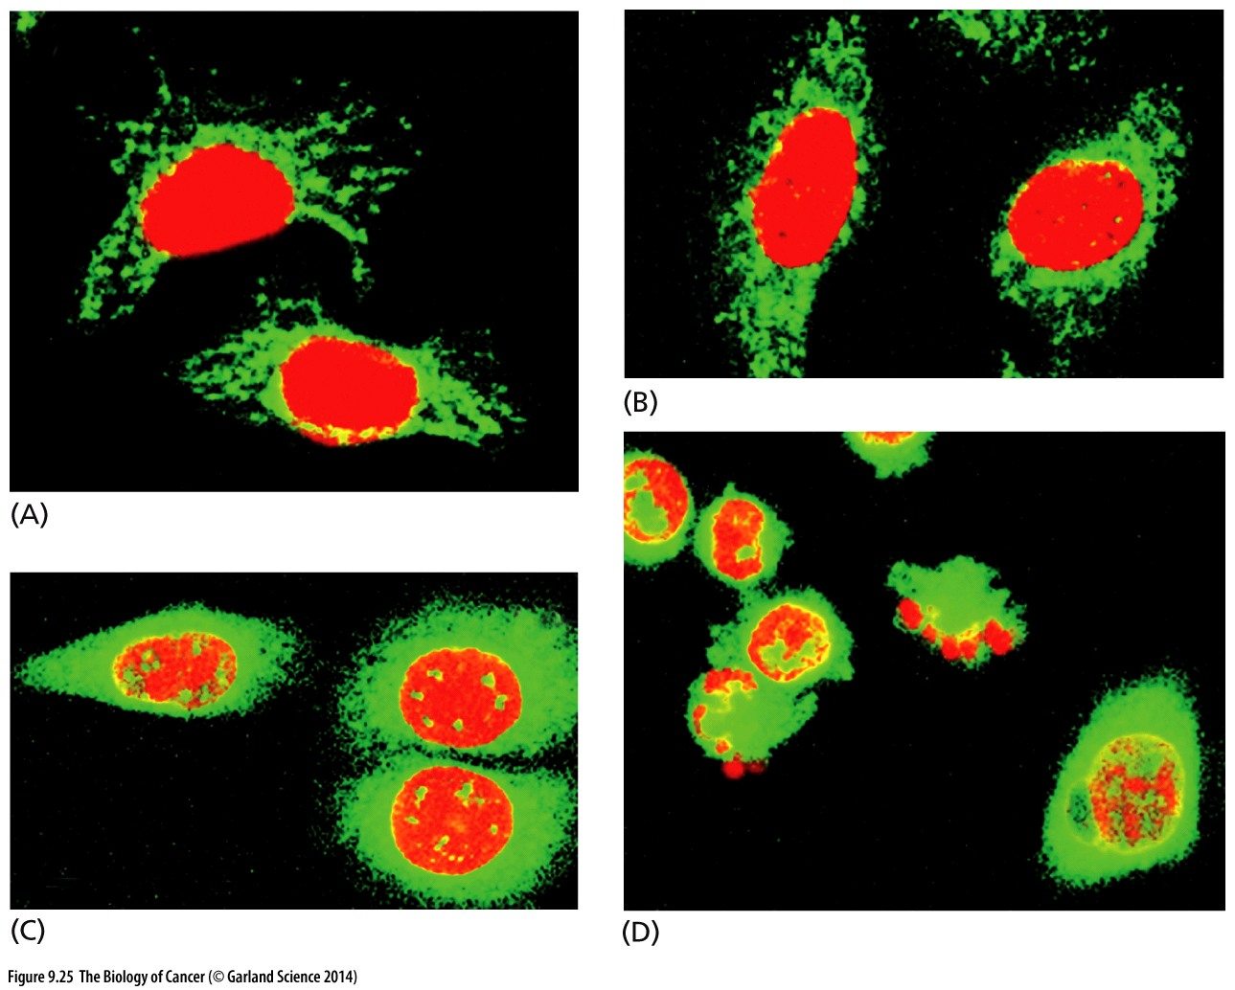
Figure 9.25 Release of cytochrome c from mitochondria into the cytosol
The presence of cytochrome c can be detected by staining with a specific fluorescence-labeled antibody (green), which contrasts with the dye-labeled nuclei (red orange). (A) Initially, the distribution of cytochrome c coincides with the distribution of mitochondria in the cytoplasm. As apoptosis proceeds, however (B, C, D), cytochrome c staining becomes increasingly uniform in the cytoplasm as this protein is released from the mitochondria into the cytosol. At the same time, some nuclei give evidence of the fragmentation that is associated with apoptosis (C, D).

Slide 48
Bcl-2 protein and cytochrome c
We now know that the Bcl-2 protein is a member of a large and complex family of proteins (Figure 9. 26) that control the flow of cytochrome c through specialized channels in the outer membrane of the mitochondrion.

Slide 49
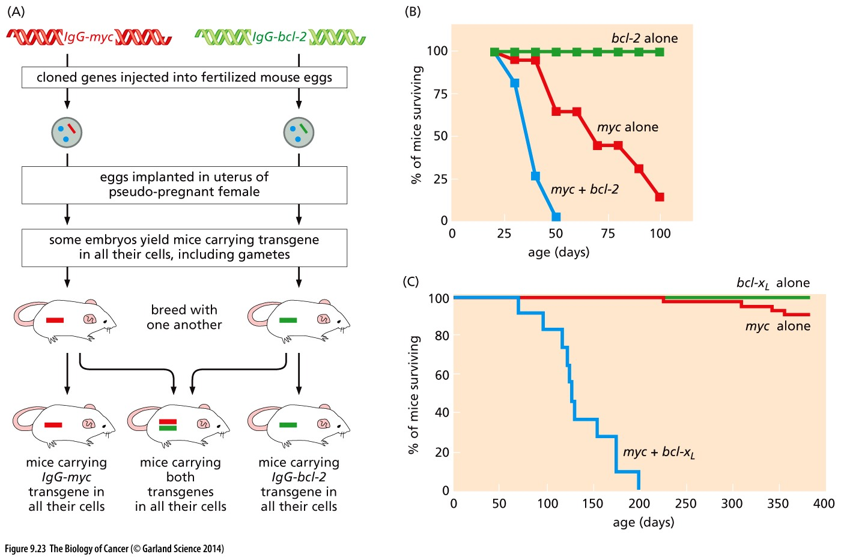
Figure 9.23 Synergy of Bcl-2-like genes with myc
Notes:
仅供参考

Slide 50
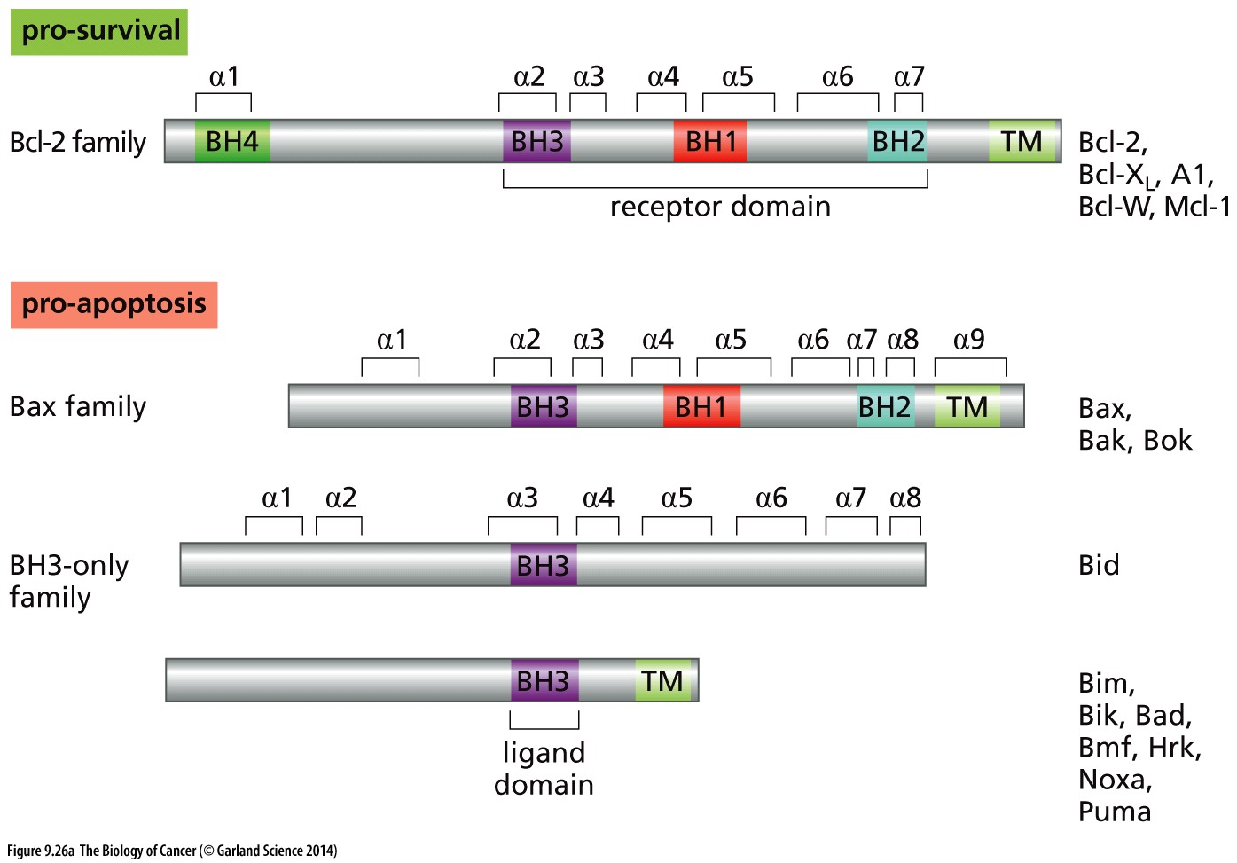
Figure 9.26 Bcl-2 and related proteins

Slide 51
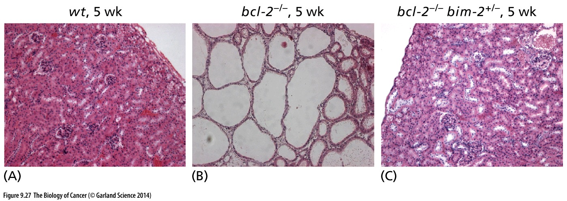
Figure 9.27 The delicate balance between pro- and anti-apoptotic proteins
(A) The wild-type mouse kidney is a well-consolidated tissue at 5 weeks of age. (B) However, deletion of both germ-line copies of the antiapoptotic bcl-2 gene (resulting in the bcl-2–/– genotype) results in widespread apoptosis and polycystic kidney disease at this age. (C) These effects can be fully reversed if one copy of the proapoptotic bim gene is also deleted from the germ line (yielding the bcl-2–/– bim+/–genotype).

Slide 52
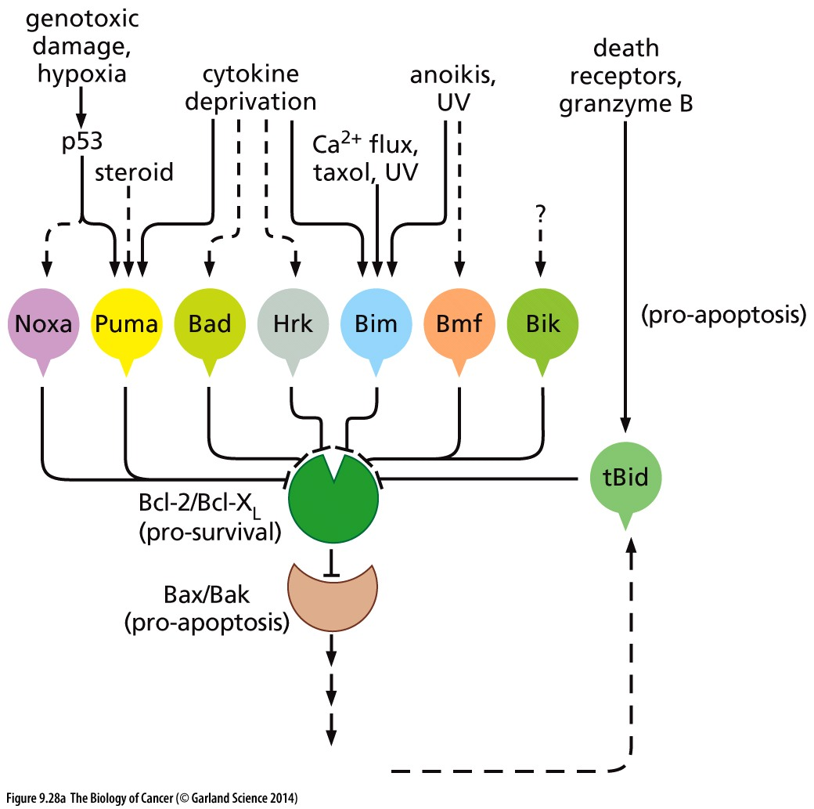
Figure 9.28 Pro-apoptotic signals acting through various Bcl-2–related proteins
(A) The rationale for the multiplicity （多样性） of Bcl-2-like proteins is that various cell-physiologic stresses operate through different pro-apoptotic proteins to antagonize antiapoptotic proteins such as Bcl-2 and Bcl-XL (green). The latter are thereby prevented from neutralizing Bax and Bak (light brown), the dominant pro-apoptotic proteins that function to release cytochrome c from the mitochondrial membrane. The caspases that have been activated downstream in the apoptotic pathway (see Figure 9.30) can also activate the pro-apoptotic function of Bid by proteolysis (cleaving it to tBid), thereby amplifying the apoptotic response.
Cyto C → caspases

Slide 53
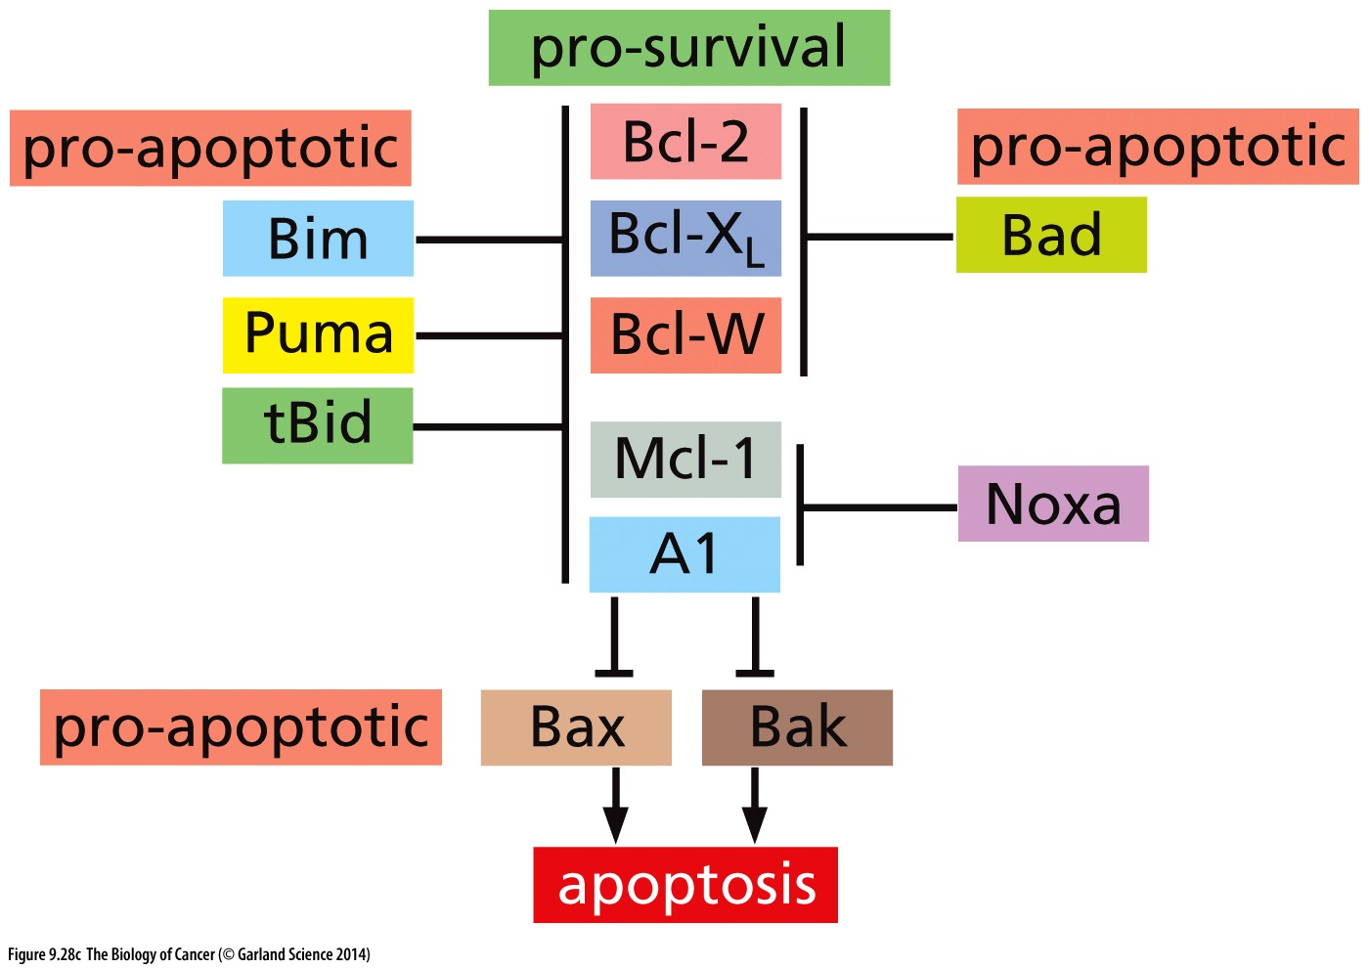
Figure 9.28 Pro-apoptotic signals acting through various Bcl-2–related proteins
Each member of the Bcl-2 family of proteins has its own set of opposing partners. At the center of this network lie the anti-apoptotic proteins Bcl-2, Bcl-XL, Bcl-W, Mcl-1, and A1. Each has its own set of antagonistic partners. At the bottom of this network lie the proapoptotic Bax and Bak proteins; if unopposed, they will promote apoptosis by opening the mitochondrial membrane channel.
Notes:
BCL-2 family protein regulate apoptosis through regulate cytochrome c release, 具体机制仅供参考

Slide 54
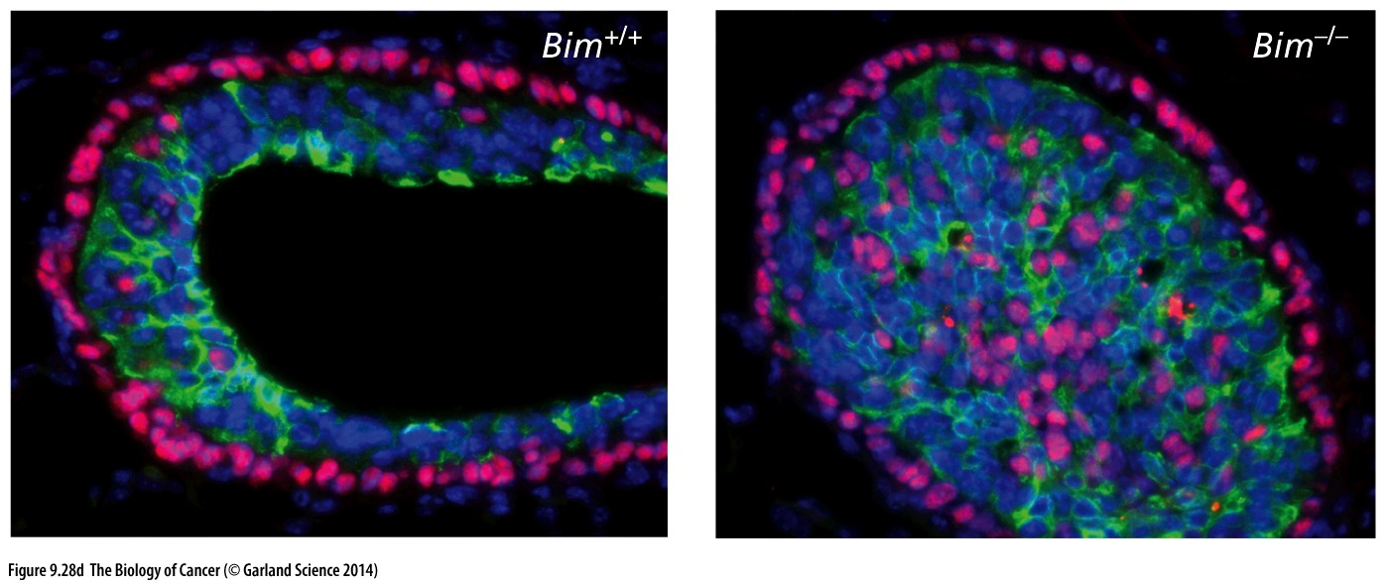
Figure 9.28 Pro-apoptotic signals acting through various Bcl-2–related proteins
In wild-type (Bim+/+) mice, a cavity is excavated in the solid tip (terminal end bud) of an elongating mammary duct. However, in Bim–/– mice, mammary epithelial cells persist, preventing normal lumen formation (right). p63, marker of basal epithelial cells (red); mucin1, marker of secretory luminal cells (green); cell nuclei (blue).
Notes:
细胞凋亡在乳腺导管发育中的作用

Slide 55
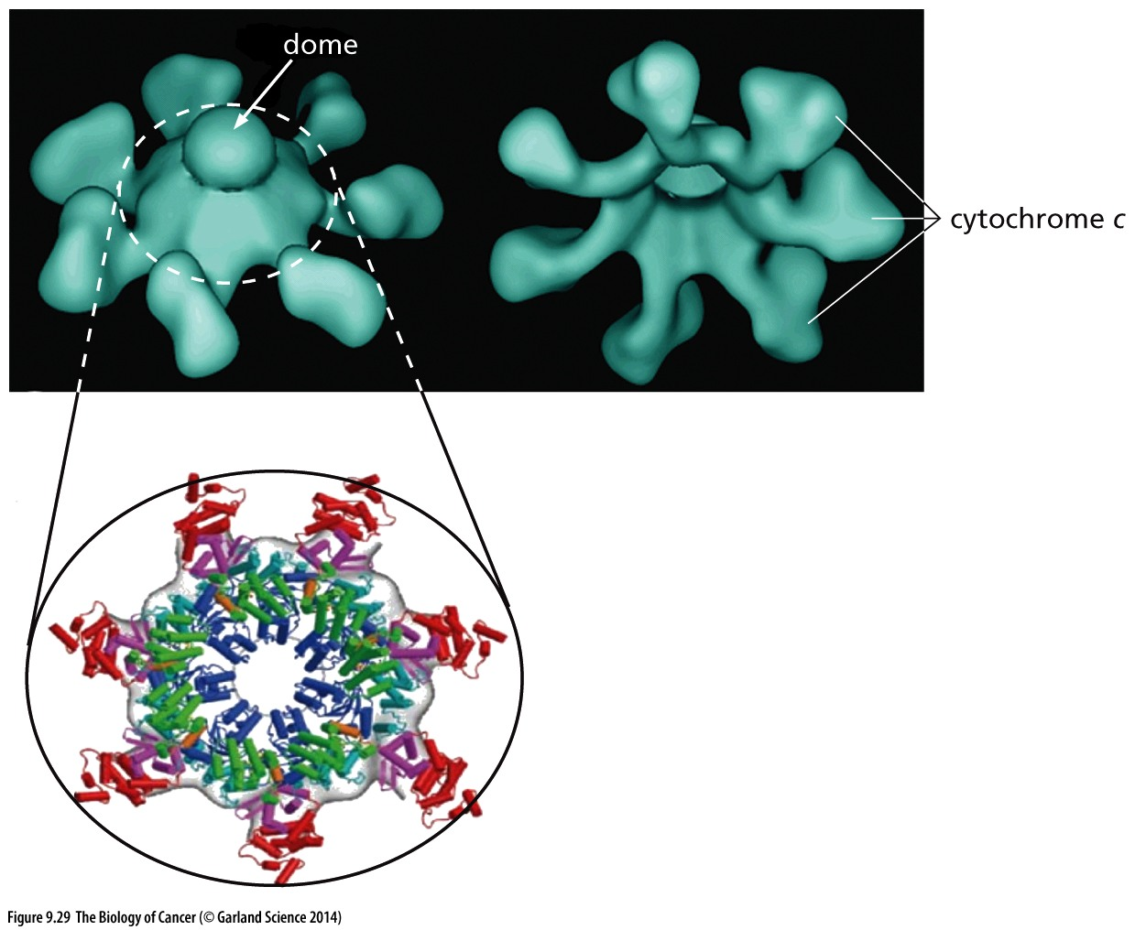
Figure 9.29 The wheel of death
The apoptosome—the wheel of death— is assembled in the cytosol when cytochrome c molecules are released from mitochondria and associate with Apaf-1. This causes the assembly of a seven-spoked wheel, in which Apaf-1 forms the spokes（辐条） and cytochrome c molecules form the tips of the spokes (above), The blue helices in the center interact with procaspase 9 to convert it into caspase 9, which then triggers the apoptotic cascade.

Slide 56
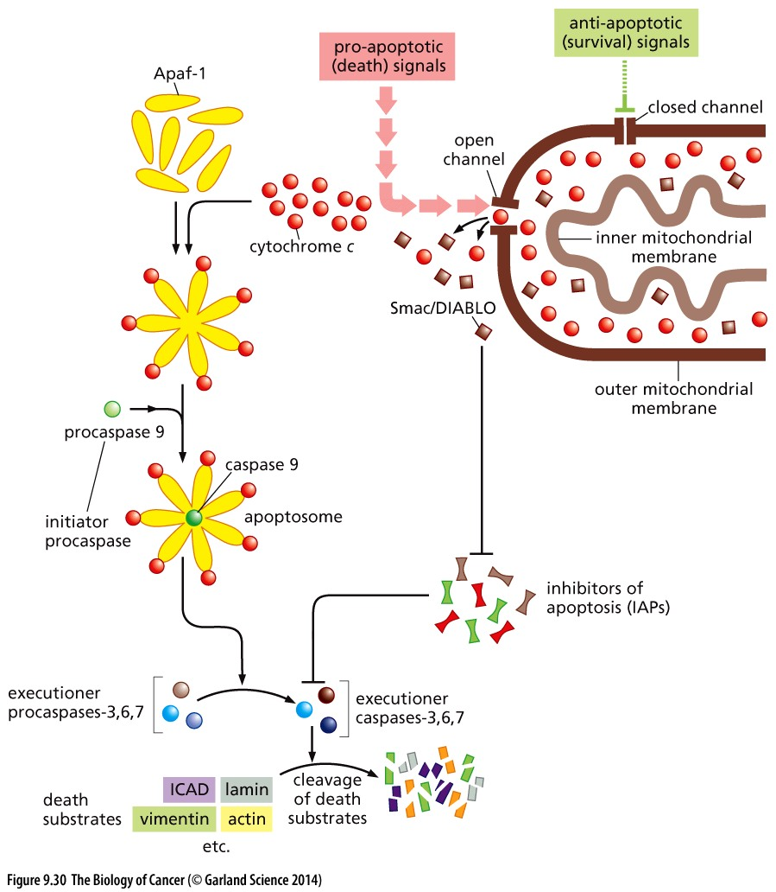
Figure 9.30 The apoptotic caspase cascade
BCL-2
Cytochrome C
caspases

Slide 57
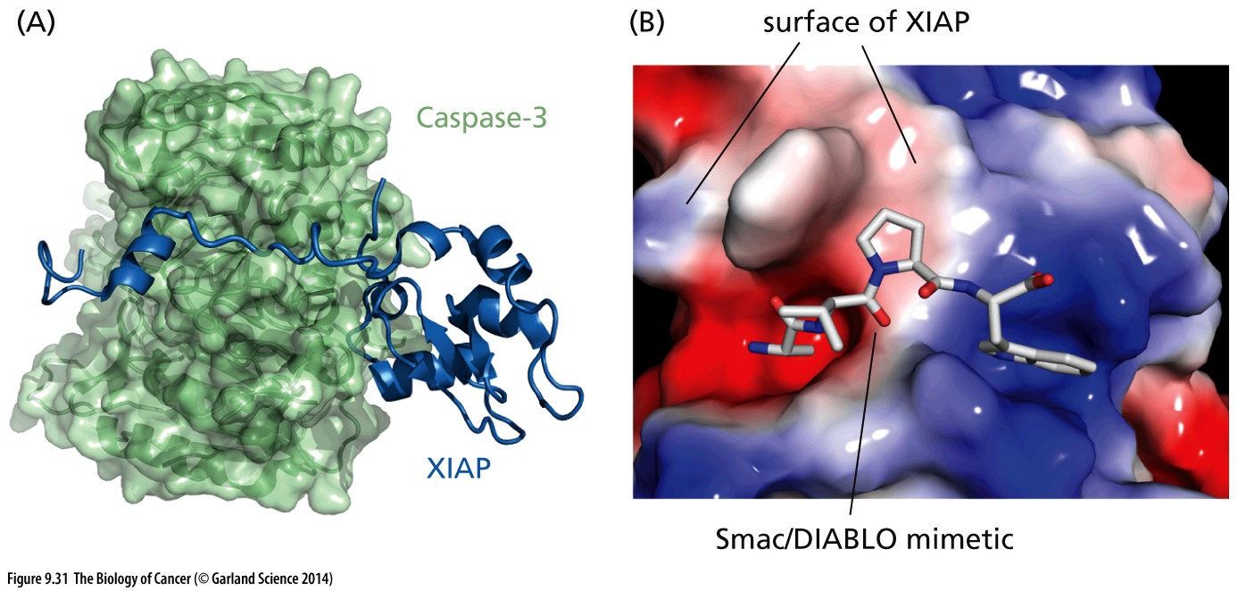
Figure 9.31 Structure and function of an inhibitor of apoptosis
IAPs (inhibitors of apoptosis) function by binding and inhibiting various caspase molecules, thereby preventing inadvertent activation of the caspase cascade and the triggering of apoptosis. (A) The BIR3 domain of XIAP binds to the substrate-binding groove of the caspase, thereby blocking its function. (B) The Smac/DIABLO molecule prevents several IAP molecules from blocking caspase action, thereby freeing the caspases to trigger apoptosis. Negatively charged surface (red); positively charged surface (blue).

Slide 58
9.14 Both intrinsic and extrinsic apoptotic programs can lead to cell death
intrinsic apoptotic programs: internal stress, p53, cytochrome C related
extrinsic apoptotic program or the receptor activated apoptotic pathway

Slide 59
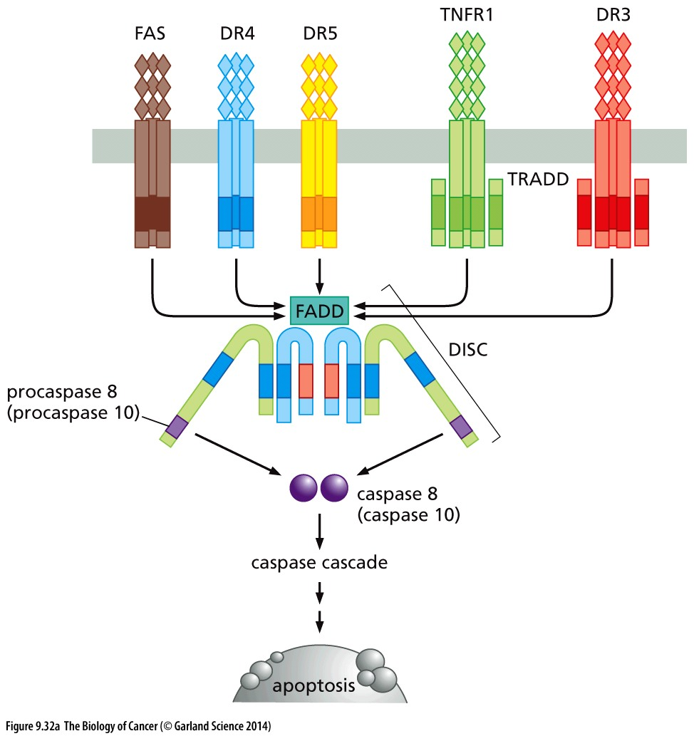
Figure 9.32 Death receptors

Slide 60
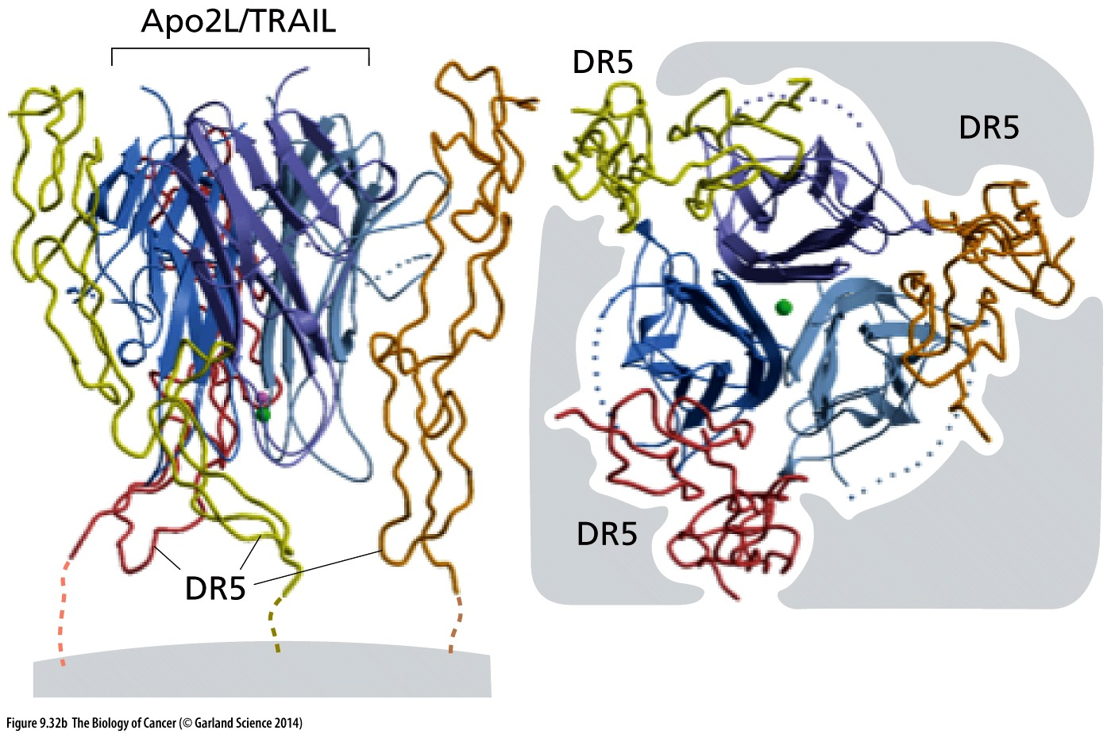
Figure 9.32 Death receptors
Shown here is the trimeric APO2L/TRAIL ligand in complex with the cognate trimeric DR5 receptor. The small green circle in the middle denotes a chelated zinc ion.

Slide 61
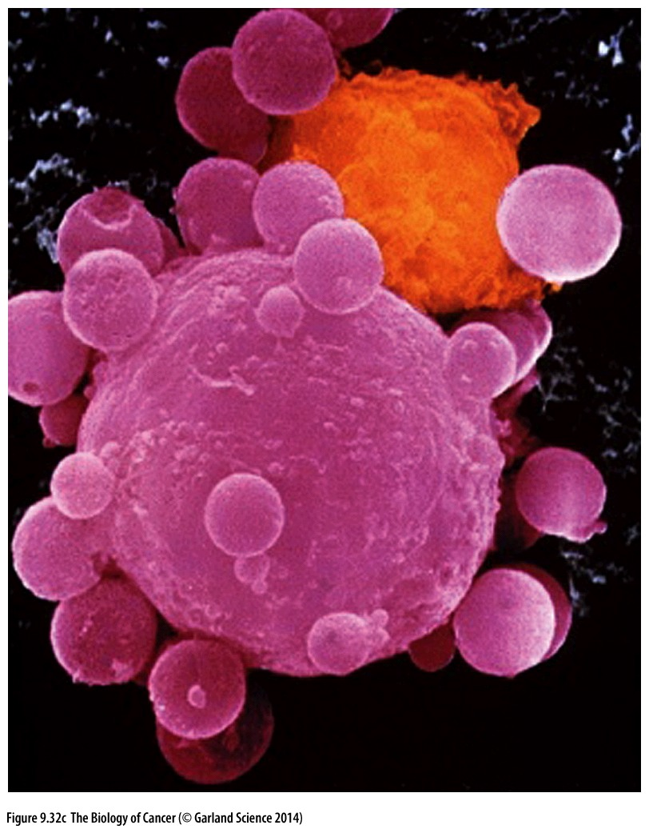
Figure 9.32 Death receptors
Death receptor ligands, notably FasL, are frequently used by cytotoxic T lymphocytes (CTLs) to kill cancer cells, which display the FAS receptor on their surfaces. (In addition, granzymes may be injected by CTLs into target cells; see Figure 9.34.) In this colorized scanning electron micrograph, a CTL (orange) is attacking a cancer cell, which is in the throes of apoptosis, as evidenced by the numerous blebs on its surface.

Slide 62
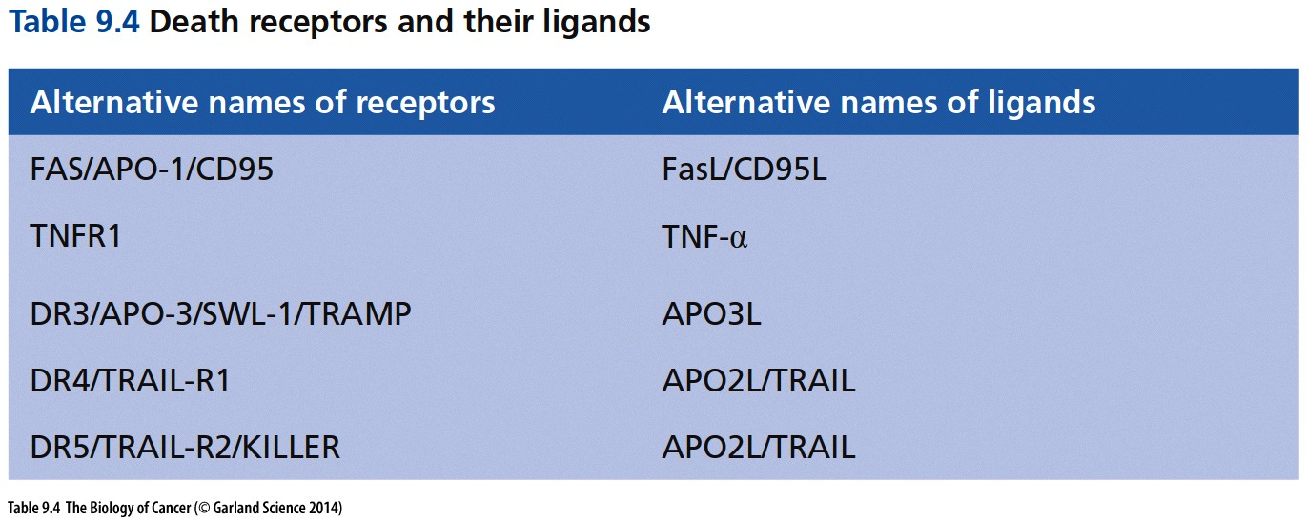
The ligands of the death receptors are members of the tumor necrosis factor (TNF) family of proteins, which includes TNF-α, TRAIL, and Fas Ligand (FasL) (Table 9.4).

Slide 63

Figure 9.34 Convergence of intrinsic and extrinsic apoptotic pathways
death receptor → caspase 8 and/or 10 →executioner caspases.
granzyme B →caspases 3 and 8.
tBid (truncated Bid)→ cytochrome c → apoptosomes

Slide 64

Figure 9.35 Activation of apoptosis by p53
p53 utilizes multiple signaling pathways to activate the apoptotic program. By inducing expression of the gene encoding the FAS receptor, By inducing expression of IGF-binding protein-3 (IGFBP-3), In addition, the activated, pro-apoptotic form of p53 drives expression of the FOXO3 pro-apoptotic transcription factor, as well as Bax (center), the proapoptotic, Bcl-2–related protein;
Notes:
具体通路细节仅供参考

Slide 65


Slide 66


Slide 67

Figure 9.36 Anti-apoptotic strategies used by cancer cells
Cancer cells resort to numerous strategies in order to decrease the likelihood of apoptosis. This diagram indicates that in various cancer cell types, the levels or activity of important pro-apoptotic proteins are decreased (blue). Conversely, the levels or activity of certain anti-apoptotic proteins may be increased (red).
Notes:
具体通路细节仅供参考

Slide 68

Figure 9.37 Autophagy and alternative forms of cell death
These electron micrographs reveal (left panel) an entire mitochondrion (below) that has been engulfed in an autophagosome. The arrows indicate structures that have the multi-layered membrane structures of an autophagosome, only one of which (right arrow) can be definitively identified because of its contents as an autophagosome. The right panel indicates an autophagosome (arrow), surrounding mitochondria (m) and fragments of endoplasmic reticulum (e).
Notes:
Role of autophagy in cancer actually is very complicated, sometimes promote cancer, sometimes inhibit cancer.

Slide 69

Figure 9.38 Reactivation of p53 induces senescence
In a mouse model of liver cancer pathogenesis, an H-ras oncogene was introduced into cultured hepatoblasts in which p53 expression was suppressed by an inducible siRNA vector construct. These cells were injected into the spleens of host mice, leading to their implantation in the liver. Tumors were imaged in vivo through light released by a luciferase gene borne by the tumor cells.

Slide 70

Figure 9.39 Multiple types of post-translational modifications of p53
The phosphorylation of p53 by various kinases represents only one type of modification that is important to its functioning. In addition, other enzymes modify it by attaching acetyl (green), ubiquityl (blue), sumoyl (purple), neddyl (yellow), and methyl (gray) groups at the indicated amino acid residues and residue numbers (black type). The identities of the modifying enzymes are indicated (various font colors) next to the amino acid residue numbers. Only a small portion of these modifications have been linked to specific p53 functions. One of these, phosphorylation of serine 46, which is accomplished by any of 4 distinct kinases, activates the proapoptotic functions of p53.
Notes:
人有3万个基因，其中P53是目前研究文献最多的基因。但是还有很多p53功能与调控目前未知，比如：如何设计药物靶向p53失活细胞？

Slide 71

Figure 9.40 The apoptotic circuit board
Notes:
具体内容仅供参考，关注p53相关信号通路

Slide 72
思考题
1，p53基因突变的肿瘤中p53蛋白的表达相比未突变的正常组织要高，原因是什么？
2，肿瘤基因组中p53基因为什么倾向于突变而不是删除？
3，设计一种策略，选择性杀伤p53基因突变的肿瘤细胞，而不伤害p53未突变的正常细胞。

